Slide 1

Motivation Through Recognition
Multiple District 2
Global Action Team – Texas Tuesday Connections
Virtual Leadership Training
May 4, 2021

Slide 2


“Two out of five volunteers stop volunteering for one or more of these reasons: not good use of time, poor use of talents, tasks not clearly defined, or not thanked.”
Why is Recognition Important?
-Excerpt from a recent volunteer survey
Member Satisfaction is the key to Retention of our members

Slide 3
Recognition is an Art
Recognition is “acknowledgement with a show of appreciation”
Art can be defined as “the conscious use of skill and imagination”
Develop a habit of recognizing the contributions of others

Slide 4
People value being appreciated for their contributions
Recognition does not have to be elaborate, just genuine.

Slide 5
Recognition: What? Why? Who? How?
There are many different types of recognition
You can give recognition to anyone
Look for reasons to acknowledge others’ service or gifts
Get started developing a habit of giving recognition – TODAY!
Recognition benefits the recipient, Lions, and the community
Leaders are responsible for giving recognition when appropriate
Recognition doesn’t happen as often as it should
*Even in failure, you can still recognize the effort

Slide 6
Everyday Recognition
Develop a personal plan for giving recognition
Formal Recognition – a certificate, medal, plaque or pin informing all of the achievement
Informal Recognition – personal reinforcement, a “thank you” note, recognizing at a meeting, or taking the Lion to lunch.

Slide 7
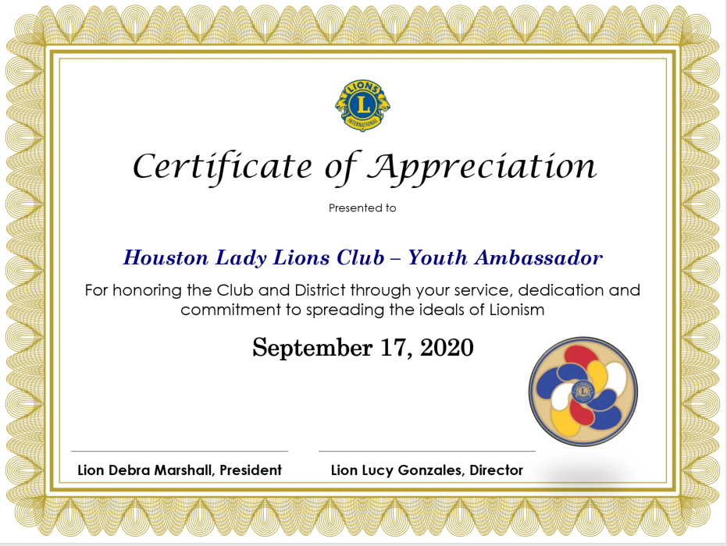
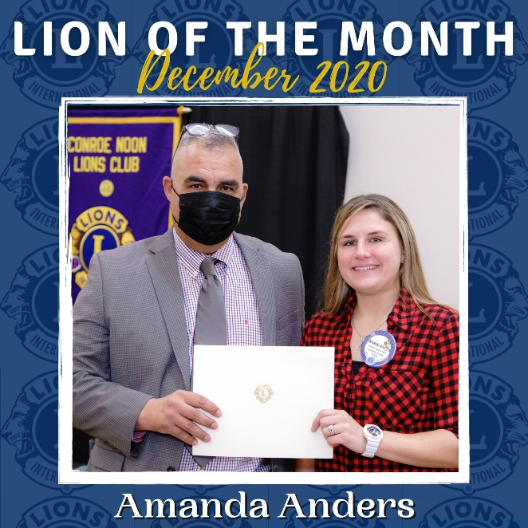
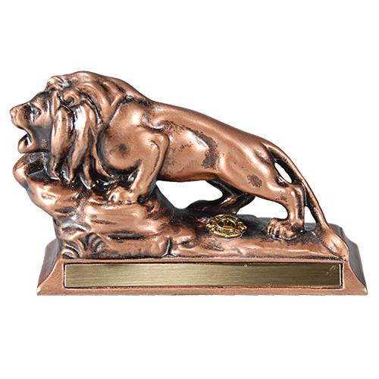
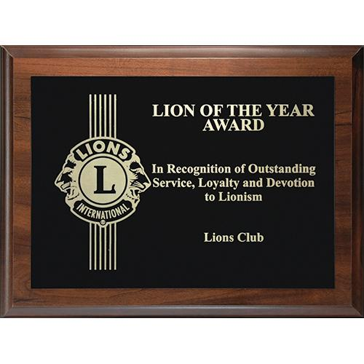
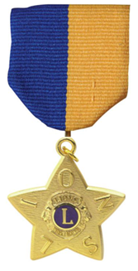

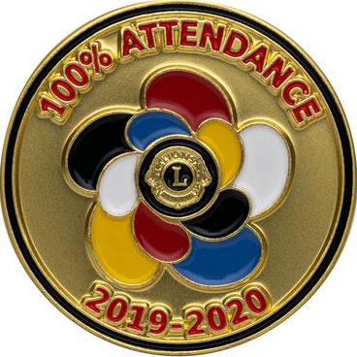
Examples of Recognition

Slide 8
What to Look for to Recognize
Recognize the importance of every job
Recognize the quality of performance
Recognize the person
Recognize the effort, the result, the process, the collaboration or the innovation

Slide 9
How do you Start?
Long-term positive performance such as perfect attendance
Exceeding expectations in the completion of a fund-raiser
Volunteering for a tough assignment
Helping other members meet their goals or overcome obstacles
Displaying “contagious enthusiasm” in working with other Lions
Making people laugh in a stressful situation
Requesting or accepting additional responsibilities

Slide 10
Continued …
Going “above and beyond” the expected performance
Keeping a calm composure under pressure
Resolving a conflict
Mentoring another Lion
Sharing important information
Introducing a prospective new member to the Club
Many, many other reasons ……

Slide 11
Why is Recognition Important?
People feel better when they believe that they are appreciated
There’s more – Recognition benefits the recipient by:
  Satisfying a basic human need to be noticed, being involved, feeling relevant or being “in-the-spotlight”
  Motivating people to continue active participation
  Signifying that they have the respect of their peers
  Increasing self-confidence to seek new challenges

Slide 12
People repeat behavior that is rewarded.
They avoid behavior that is punished.
They drop or forget behavior that produces neither result.

Slide 13
Benefits of Recognition to the Lion
Increases Productivity
Improves Morale
Aids in Member Satisfaction
Leads to Retention
Supports Membership Growth

Slide 14
Benefits of Recognition to the Community
Empowers Individuals
Informs the public of our programs and goals
Increases our ability to Serve
Raises awareness of the need for community service

Slide 15
“Feeling gratitude and not expressing it is like wrapping a present and not giving it”
Lions are serving in our communities and across the State
The Pandemic has forced Lions to identify creative ways to serve emerging needs
Lions need to feel valued by their clubs, districts and communities

Slide 16
Lions are serving & deserve recognition – so what is preventing us from delivering that?
I don’t know how
I don’t have time
People don’t care about it that much – REALLY?
It’s not my job
I don’t believe in giving awards to people for just doing their job

Slide 17
Continued …
It becomes meaningless if done too much – insincerity more that quantity is the real problem
I’m very limited in what I can do
Sometimes it’s awkward and uncomfortable
People will think they’ve made their impression, and then they’ll stop working hard
Since I don’t get recognized, why should I recognize others?

Slide 18
Everyday Recognition
“Volunteers are not paid – not because they are worthless, but because they are priceless”
-Sherry Anderson

Slide 19
Basic Guidelines
Think outside the parameters of formal recognition awards
Determine what motivates the recipient
  Pay attention to them – their activities, hobbies, etc.
  Learn about their families and interests
  Talk to their friends
  Get to know them, and don’t be afraid to ASK what it is that makes them feel appreciated
Make sure the recognition is appropriate
Make sure the recognition is genuine

Slide 20
Leadership’s Challenge
“You can’t buy people’s commitment – to get them to care, to stay late, or come in early – with just thank-you notes, stickers or plaques. What makes these effective is the genuine concern and respect you show for those who are doing the work”

Slide 21
Ways to Recognize Lions
Recognize Lions through the words you say …
Recognize Lions through the ways you communicate …
Recognize Lions by providing opportunities …
Recognize Lions by giving responsibility …
Recognize Lions by being proactive …
Recognize Lions with simple gifts …
Recognize Lions in different roles …
Recognize Lions in unique ways …
Make the Lion feel they are VALUED!

Slide 22

Your Take-Away
Who can you recognize for outstanding achievement?
What creative method will you use?
How will you match the recognition to the individual Lion?

Slide 23

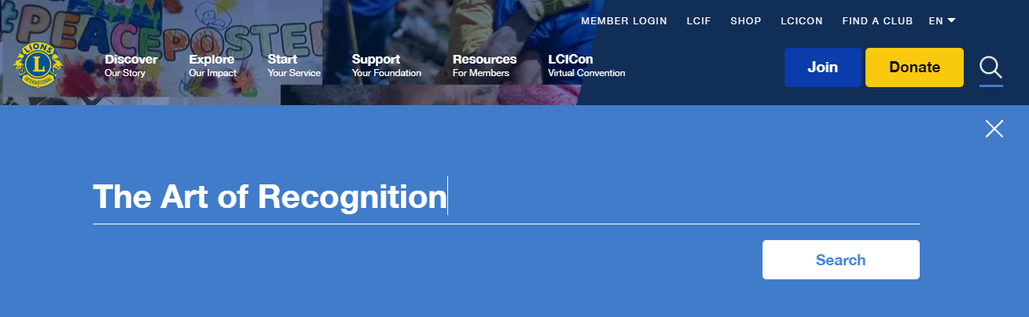
Resources
Lions University provides courses on member motivation, conflict resolution, the Art of Recognition and more
Download a copy of “The Art of Recognition” from the Lions Clubs International website
https://www.lionsclubs.org/en/v2/resource/download/79864144%20

Slide 24
Motivation Through Recognition
?
Questions
PDG Mark Roth
MD2 – GMT Coordinator
MarkWRoth@aol.com
713.962.4194
Thank you for the opportunity to join you tonight!

