Slide 1

Extension
New Club Development
Presented by
PDG Mark W. Roth, MD-2 GMT Coordinator
MarkWRoth@aol.com
Notes:
Extension is the lifeblood of our association. New Clubs bring more Helping Hands to perform needed community service, and rejuvenate our Districts with more caring, compassionate Lions

Slide 2

Objectives
To help understand the importance of new club development in the community
To gain knowledge and understanding on recruitment methods and tools needed for new Club recruitment
To gain knowledge and understanding on conducting the informational and organizational meeting for a new Club
To gain knowledge and understanding on the new Club chartering process
Notes:
The goal of this presentation will be to help you understand the importance of bringing new Lions Clubs into our communities, and gain a comfort with the overall Extension process
There are a number of methods for creating new clubs, and many tools to help make that process a smooth one
This presentation will help describe the overall extension process and include mention of the different types of meetings that lead to the successful chartering of your new Club

Slide 3
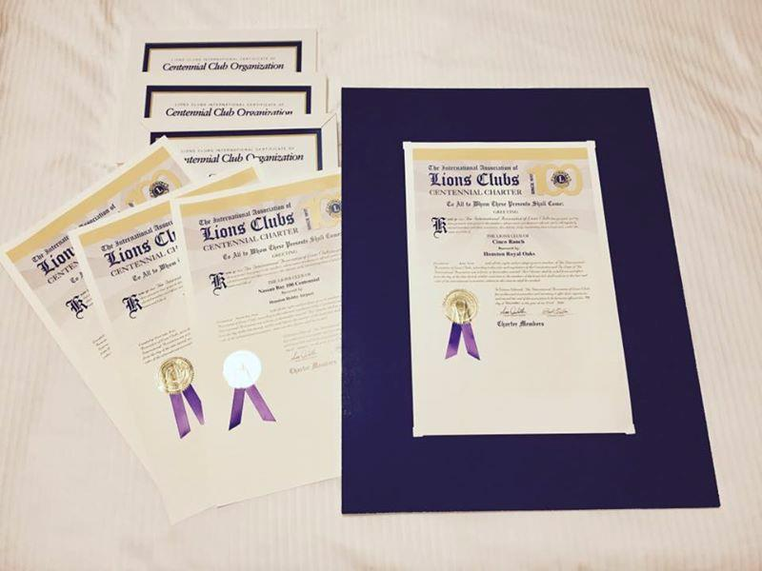

Why Lions Need New Clubs
Lions Clubs offer people the opportunity to give back to their community and help those in need. The following are benefits to forming a new Club.
Benefits to the Community
Opportunity to serve
To make a difference in the lives of others
To introduce new service projects in local communities
Benefits to the Lions District
To fill unmet needs
Encourage families to serve together
Rejuvenate and grow membership in the District
Develop and grow new leaders in the District
Notes:
We all know that new Clubs are essential to District and State growth.
The communities with new Clubs benefit with a focus on their unique needs, and the District benefits with the passion for service that new members bring.

Slide 4
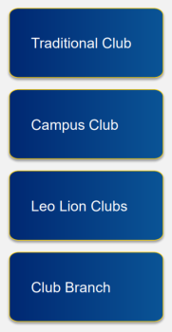
New Club Formats
Our world is ever changing, and we want the new Club to fit the lives of the members. Below are club types available
Most common Lions Club
Ideal for a group of community-minded people
Offers flexibility and serves a variety of communities
College students make an impact on college campus
Students build valuable leadership and business skills
Students are eligible for student discounts to join a Lions Club
Provide an ease of transition from Leo members to Lions
Leo years of service can be credited to Lions Club membership
Special dues discounts available for Leo to Lion entrance fee
Club Branch is part of an existing parent Club
Branch Club plans its own projects and activities
Offers flexibility and serves a variety of communities
Notes:
Depending on the specific focus or prospective club profile, there are a number of new Club options available to your Extension Team
A Traditional Club is the most common Club type and provides many opportunities for prospects to serve in areas important to their members
Campus Clubs are great options for communities where college campuses are located. They give students an opportunity to develop leadership and project management skills and serve needs otherwise left unmet
Leo to Lions Clubs serve to continue the engagement of young Leos into the greater family of Lions
Branch Clubs remain a great option where you fall short of the minimum number of members to charter a Traditional Lions Club. Also, for Clubs with Lions whose personal circumstances have changed and who can no longer participate in Club meetings and activities, it is far better to form a Branch for them to remain active members than it is to simply let them drop. A minimum of 5 Lions are needed to establish a Branch Club.

Slide 5
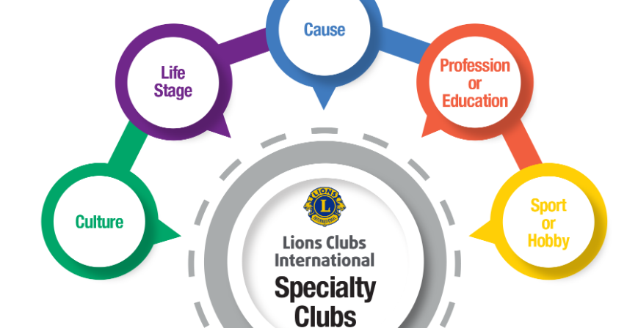
Notes:
Creating Specialty Clubs is a fast-growing trend among Lions Clubs. It allows for the introduction of other areas of service focus outside the traditional areas of our older, more established Clubs. They can be formed around a specific member type, age or profession, or around a specific area of service – like Veterans, Biker Clubs or even Cigar Smokers!

Slide 6

Join Together Club
Requirements
Existing non-profit organization
$300 Application fee – no individual ap fees
Only 15 Members to charter
Benefits to being a part of the Lions family:
Be part of the world’s largest service organization dedicated to improving communities in 200+ countries and territories
Insurance coverage for all club meetings, projects, and events
Associated with a trusted and respected name to add credibility to fundraising and volunteering
Notes:
The Join Together Club option is still available this year for new clubs. This option takes an existing organization and converts it to a Lions Club. The minimum number of Lions for this Club type is 15 and the charter application fee is only $300, regardless of the number of new Charter members.

Slide 7
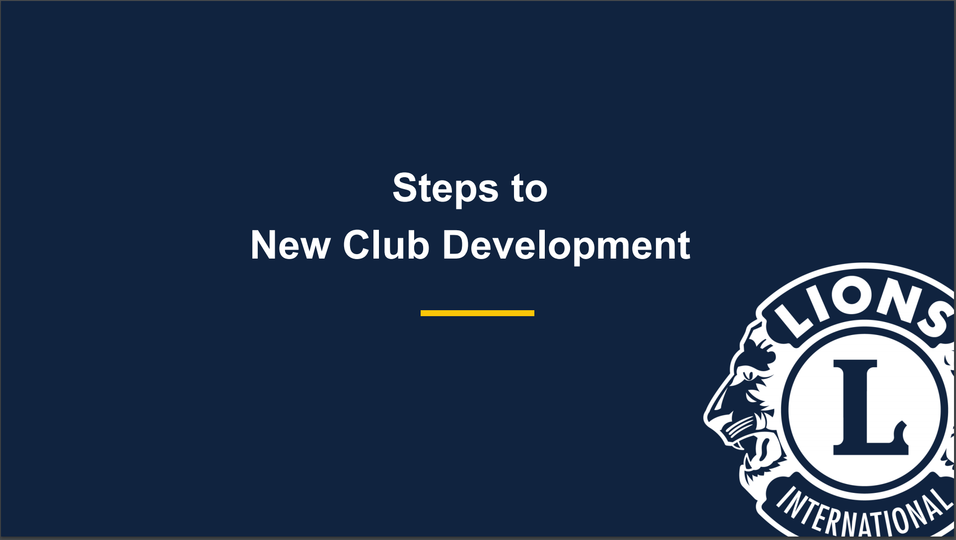

Steps to New Club Development
Notes:
Now we will break down the work of Extension into its parts to help you understand what it takes to charter a new Club and who can take part …

Slide 8
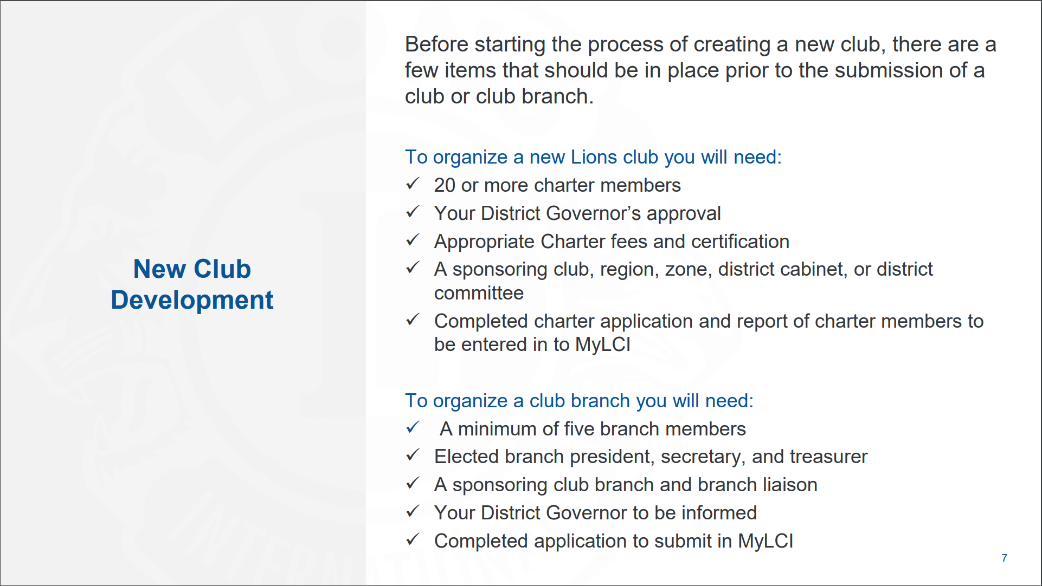
Notes:
The basic steps to charter a new club are simple (Review the basic needs on the slide) For a new Traditional Club, everything is completed through MyLCI.
After the prospective Branch members are added to the parent Club, the process is completed the old-fashioned way – paperwork needs to be submitted to LCI’s Membership Department to complete the process.

Slide 9
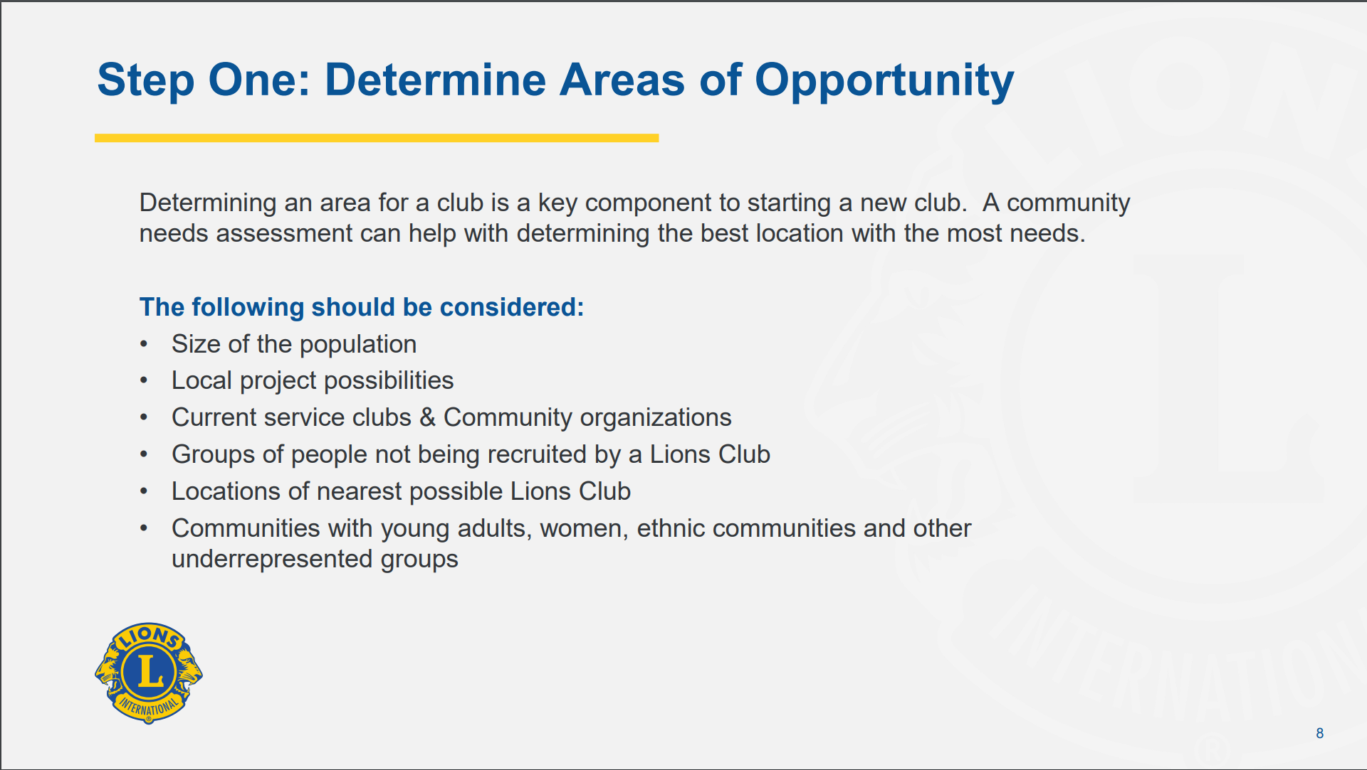
Notes:
In the North American Membership Initiative, or NoAMI, resources page on the LCI website, you can locate a link to pull-up an interactive map so you can review the location of existing Clubs within your District.
This gives you a glimpse at the locations where Lions Clubs might be needed. Once you identify several potential sites, begin pulling together information and develop a community profile. This will help you prioritize potential locations and begin development of your 2-3 month extension plans

Slide 10
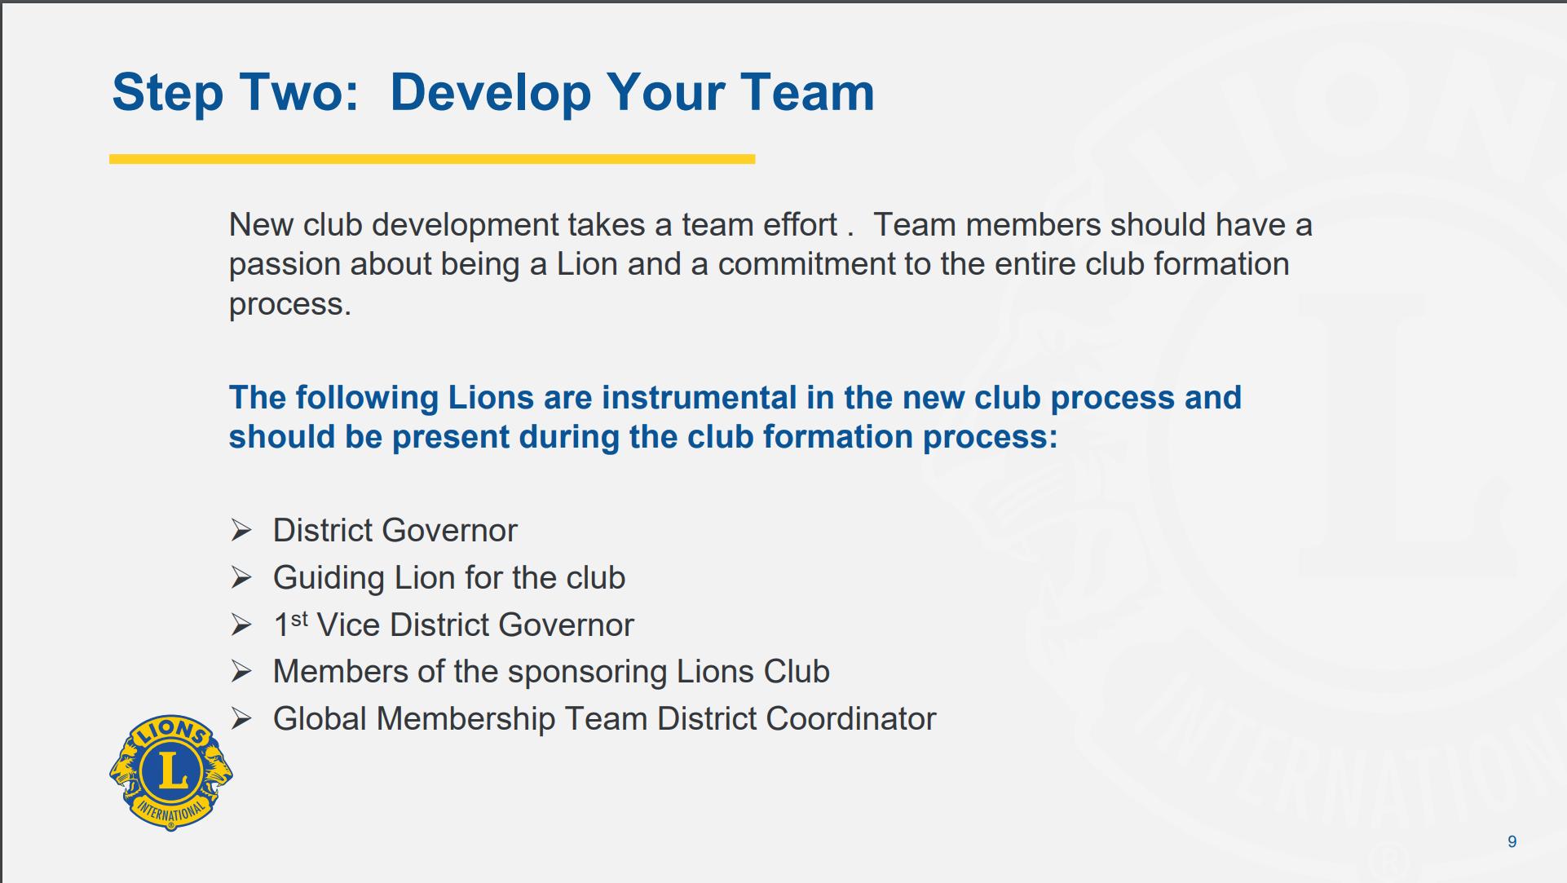
Notes:
Extension is not a one-Lion job. It takes a Team to successfully form a new Lions Club. DGEs should consider selecting and training Extension Teams well in advance of assuming their position as DG on July 1st.
Also, part of your plan is to have selected Guiding Lions to help the club for its first couple of years. The sponsoring Club is a good place to recruit volunteers for that position. They can also help with the new club development project, too.
If you don’t have a lot of depth in the area of Guiding Lions in your District, your GLT should plan for recruitment and training

Slide 11
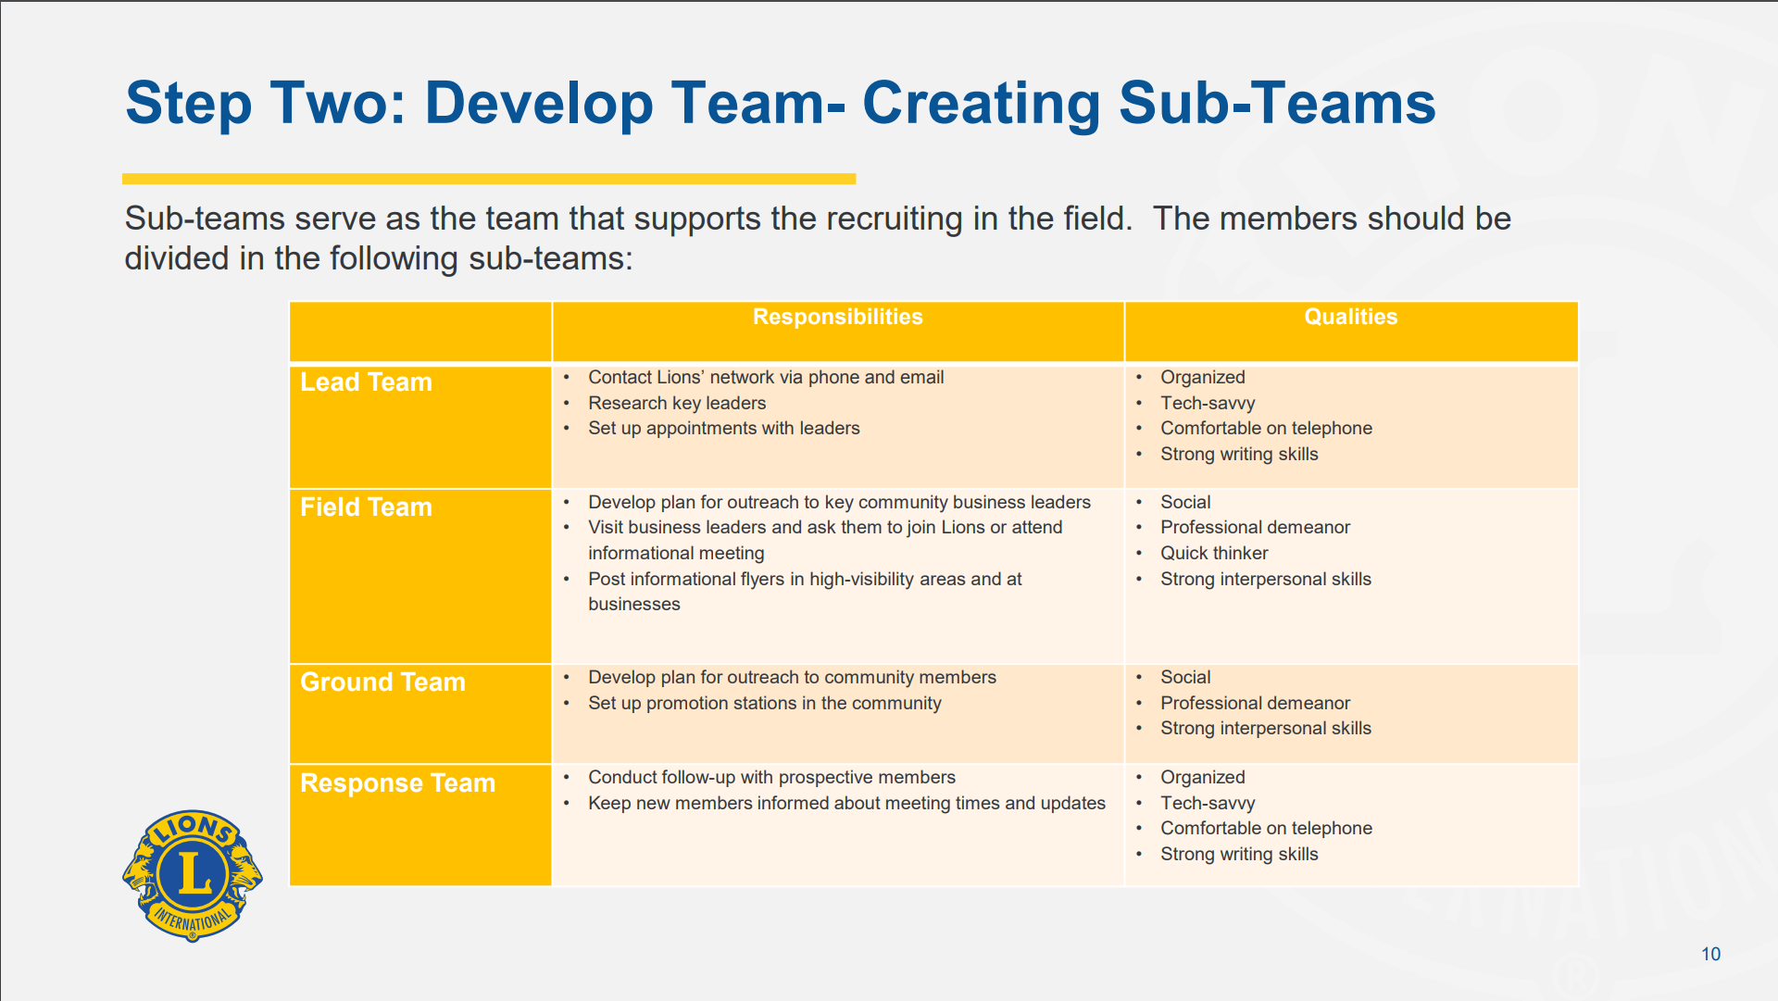
Notes:
Just about every Lion in your District has one or more of the skills needed in new club development.
If you are not comfortable with the face-to-face interactions and “inviting” strangers to join a new club, but you are great with planning an event, then you should pass on the canvassing part and put your efforts toward planning one of the meetings or coordinating resources and managing supplies.
This slide will help you understand the qualities and characteristics for each role on the Extension Team.
Again, DGEs should look at their members and see who might fit into each of the areas before you start assembling your Extension Teams

Slide 12
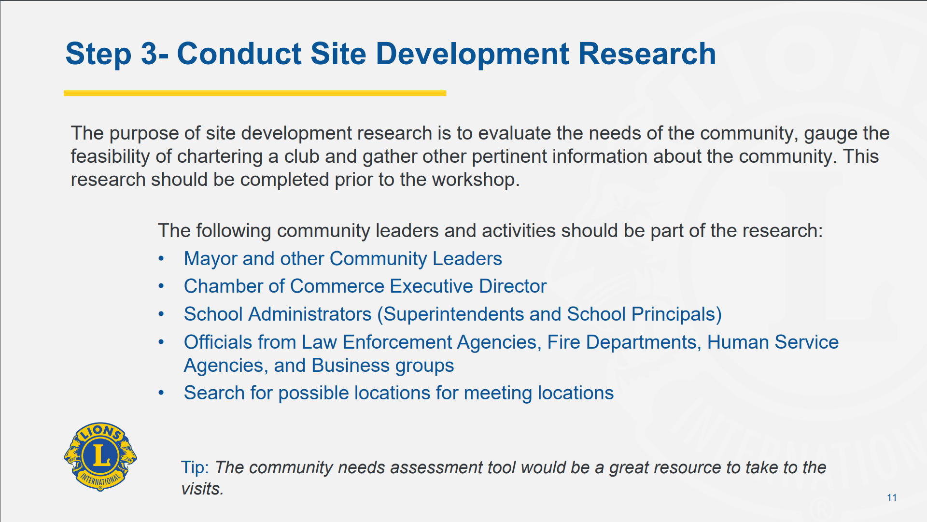
Notes:
Your Lead Team will develop a community profile and conduct research on the potential of a prospective area.
This team member (or members) will provide the research to your field team, so they get a clear picture of the potential in the community.
Even if you choose to bring in an LCI New Club Consultant to help with the groundwork, you will still need to conduct the site development research in advance.

Slide 13
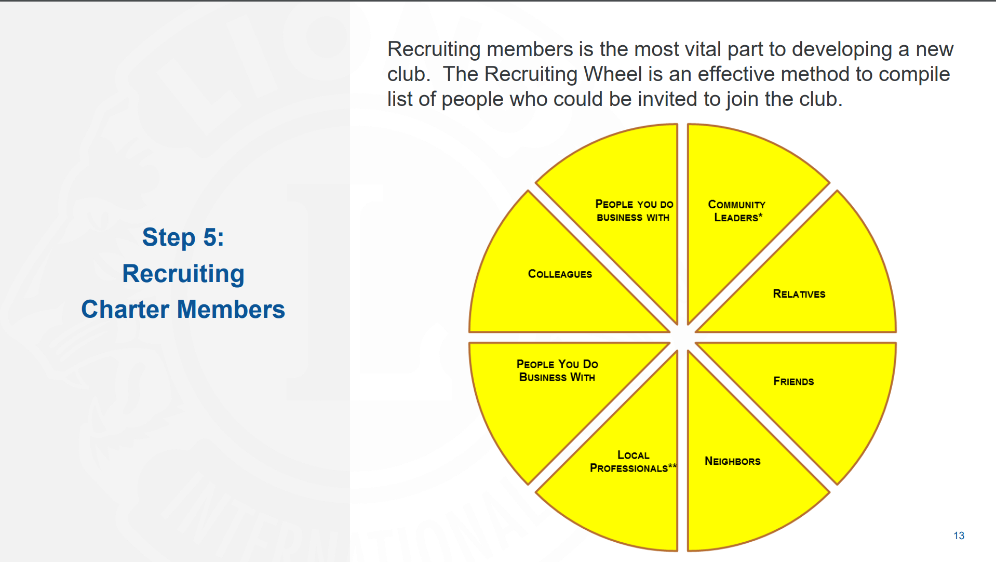
Notes:
Recruiting is the fun part – it’s where you get to invite people to join you on the Lions Mission to serve others.
As you find interest among your prospects, be sure to use this prospecting wheel to probe them for other, like-minded individuals whom you could reach out to

Slide 14
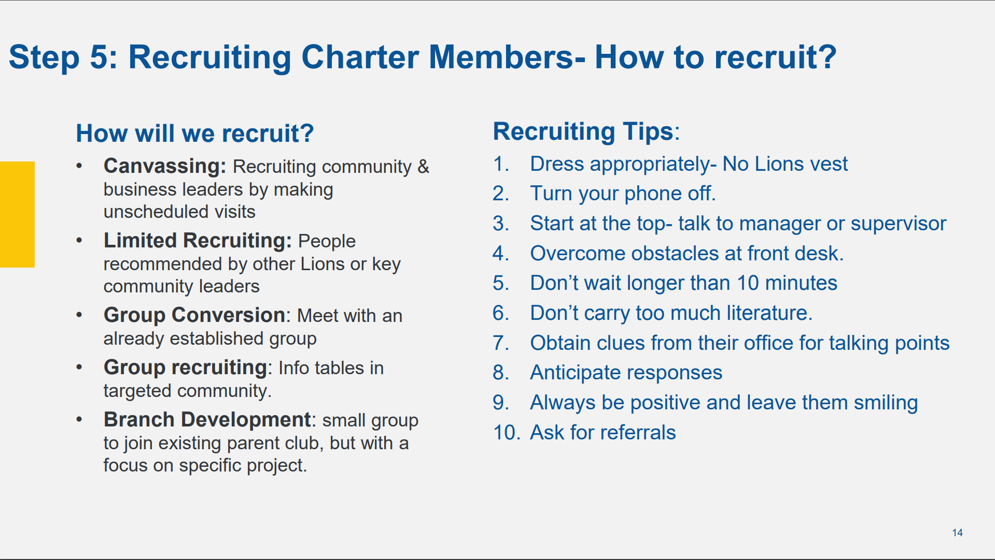
Notes:
There are different methods for conducting the new member canvassing. Most of us think we have to take a clipboard and hit the streets. That may work for some new club projects, but not for all.
The easiest type of canvassing involves a more targeted approach where you are looking for certain member types – by profession on club focus.
It is very important to dress for the audience. If you are recruiting from professionals, you want to look a bit more formal – jacket or blazer. If you’re looking to meet with a group of recreational bikers, then dress a little less formally – usually a Lions logo’ed shirt with a collar.

Slide 15
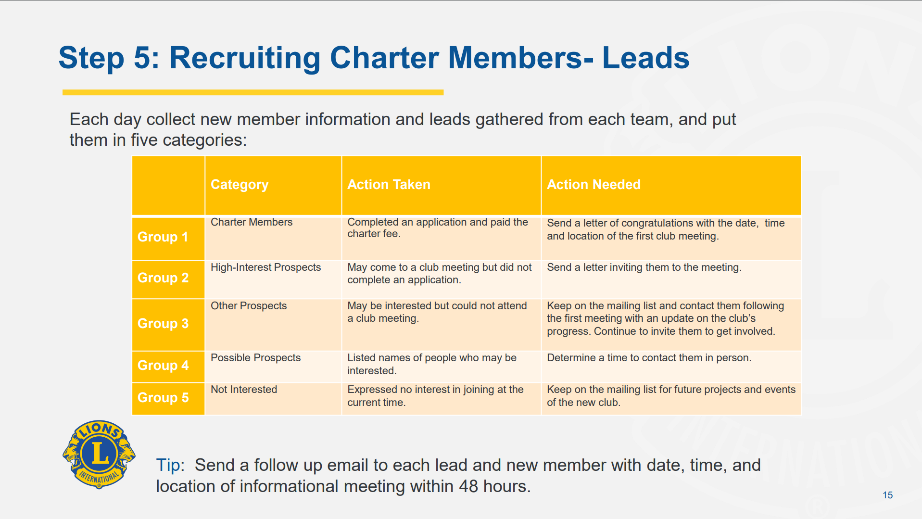
Notes:
Make good notes on each of your contacts. Some will be definitely joining, others will be maybe’s and still others will be not interested at all. Tailor your follow-up communication to their level of interest. But remember this – keep detailed notes on everyone you talk with about the new Club. This will help in the follow up.

Slide 16
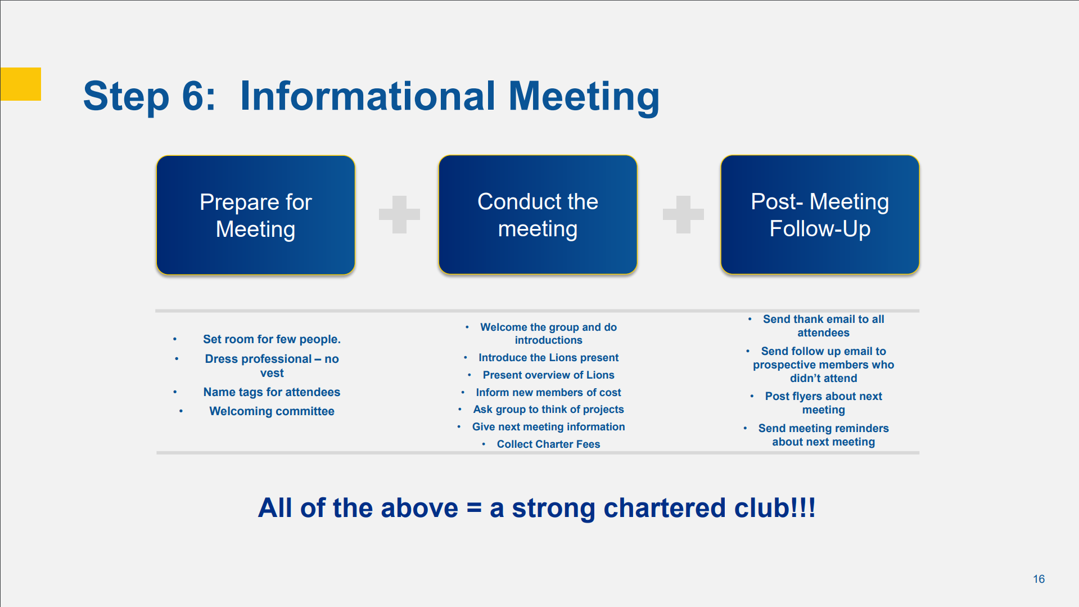
Notes:
So, now you’ve gathered several interested prospects, some definite joiners, and some maybe’s. Schedule your Informational meeting.
At the Informational meeting, you will provide a brief overview of Lions and how the community will benefit from their new Lions Club. Get the new members thinking about the ways the new Club could serve the needs in the community.
Review the prospecting wheel and keep your prospects thinking about who they might like to see joining the new club.
After the meeting, your Response Team will provide the appropriate follow-up with your attendees.

Slide 17
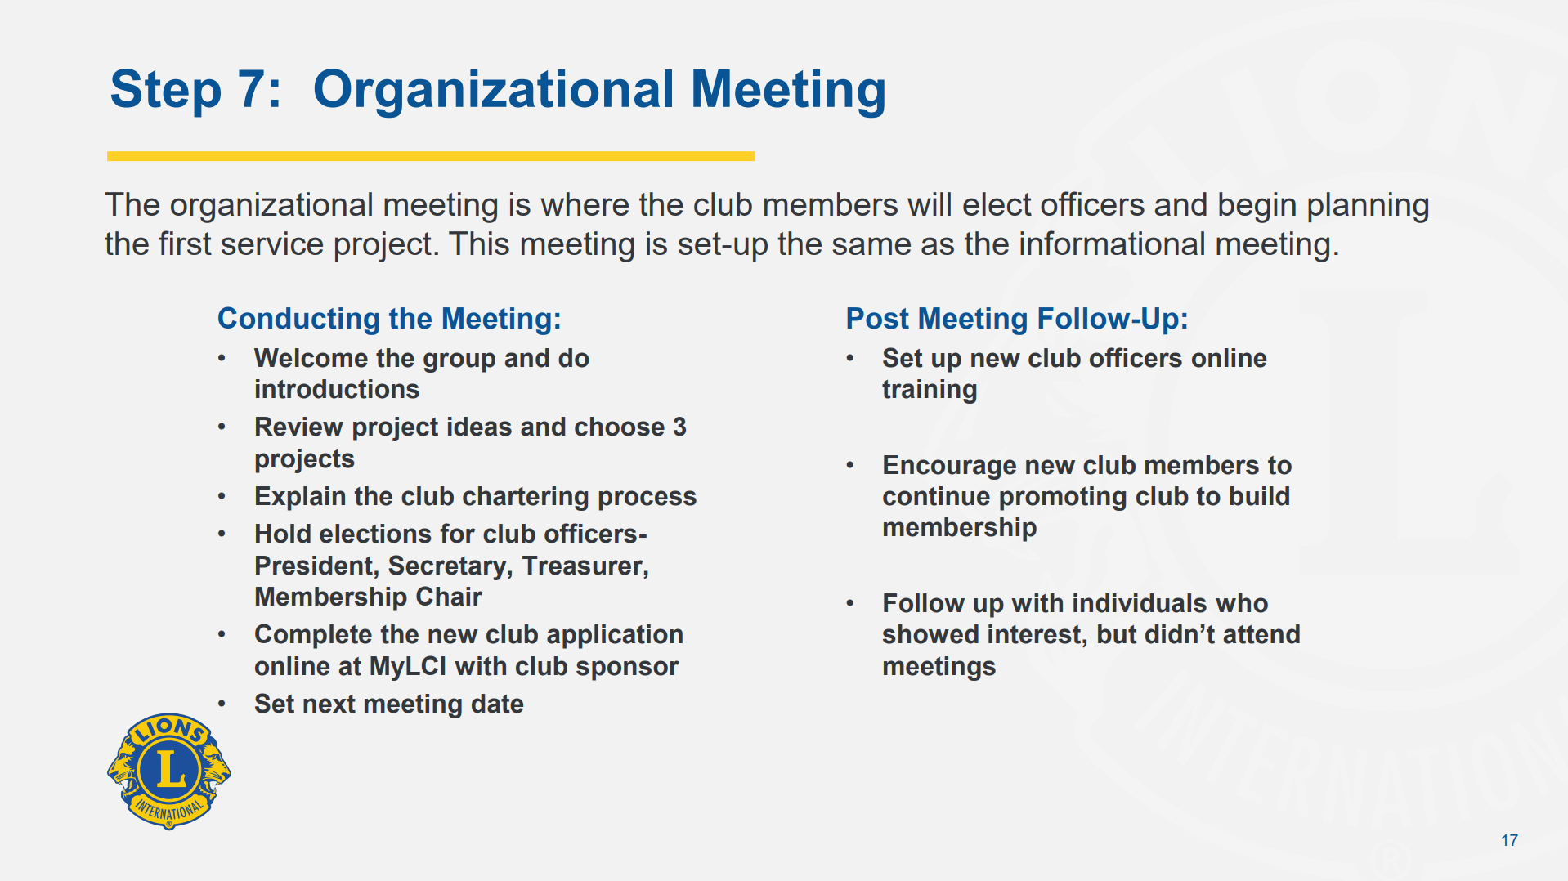
Notes:
You’re ready to go – you have your minimum number of new Lions.
Keep the members focused on generating new club project ideas
Review the chartering “next steps” and make sure that all new members understand the dues and financial expectations
Elect your new Club’s officers – President, Secretary, Treasurer and Membership Chair
Now you’re ready to complete the chartering in MyLCI.

Slide 18
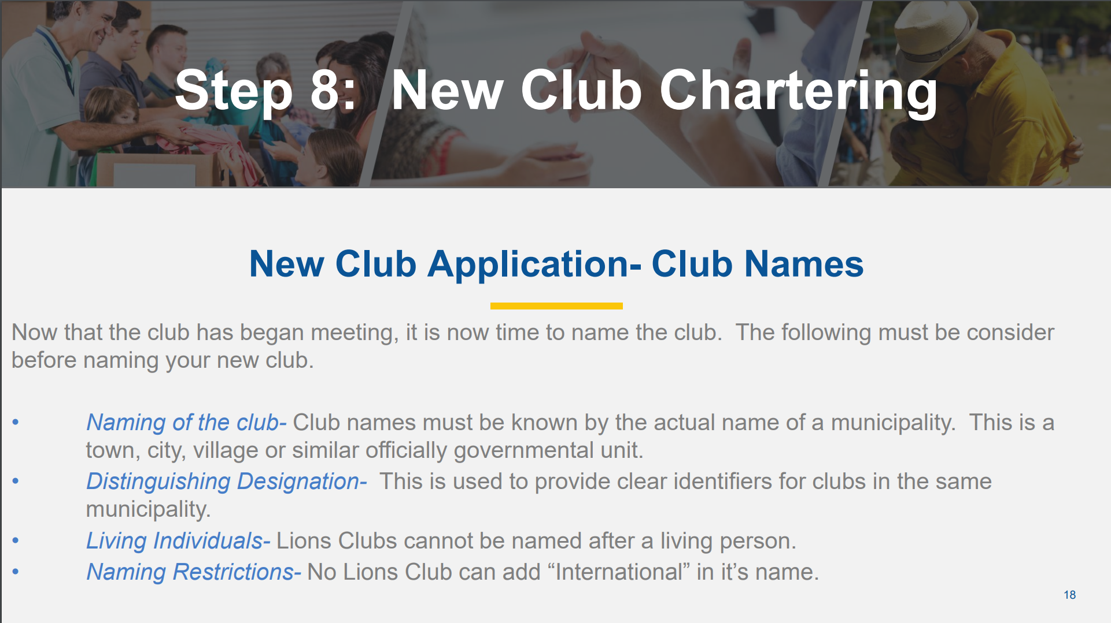
Notes:
Naming the new club can be tricky if there is no defined municipality. If you know this in advance, you may be able to communicate with LCI New Club Development staff and get that resolved so you can provide appropriate guidance to the Club.
Some examples may include:
- New England Medical Lions Club
- Panhandle Kids Count Lions Club

Slide 19
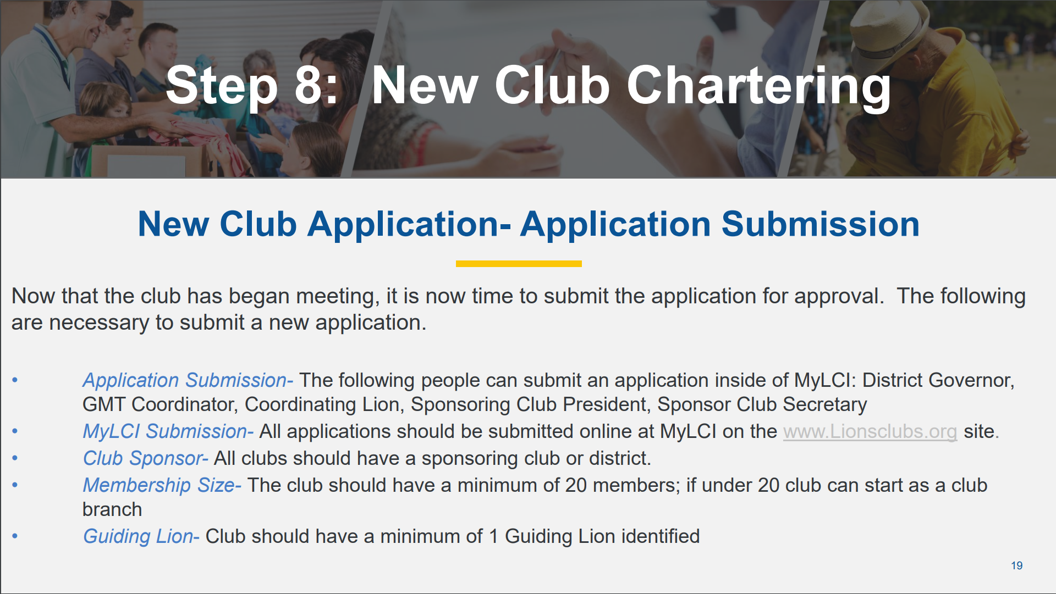
Notes:
The District GMT Coordinator, Cabinet Secretary or District Governor can launch the New Club Application process in MyLCI. The District Governor needs to add in the Guiding Lion(s) and New Club Organizer(s).

Slide 20
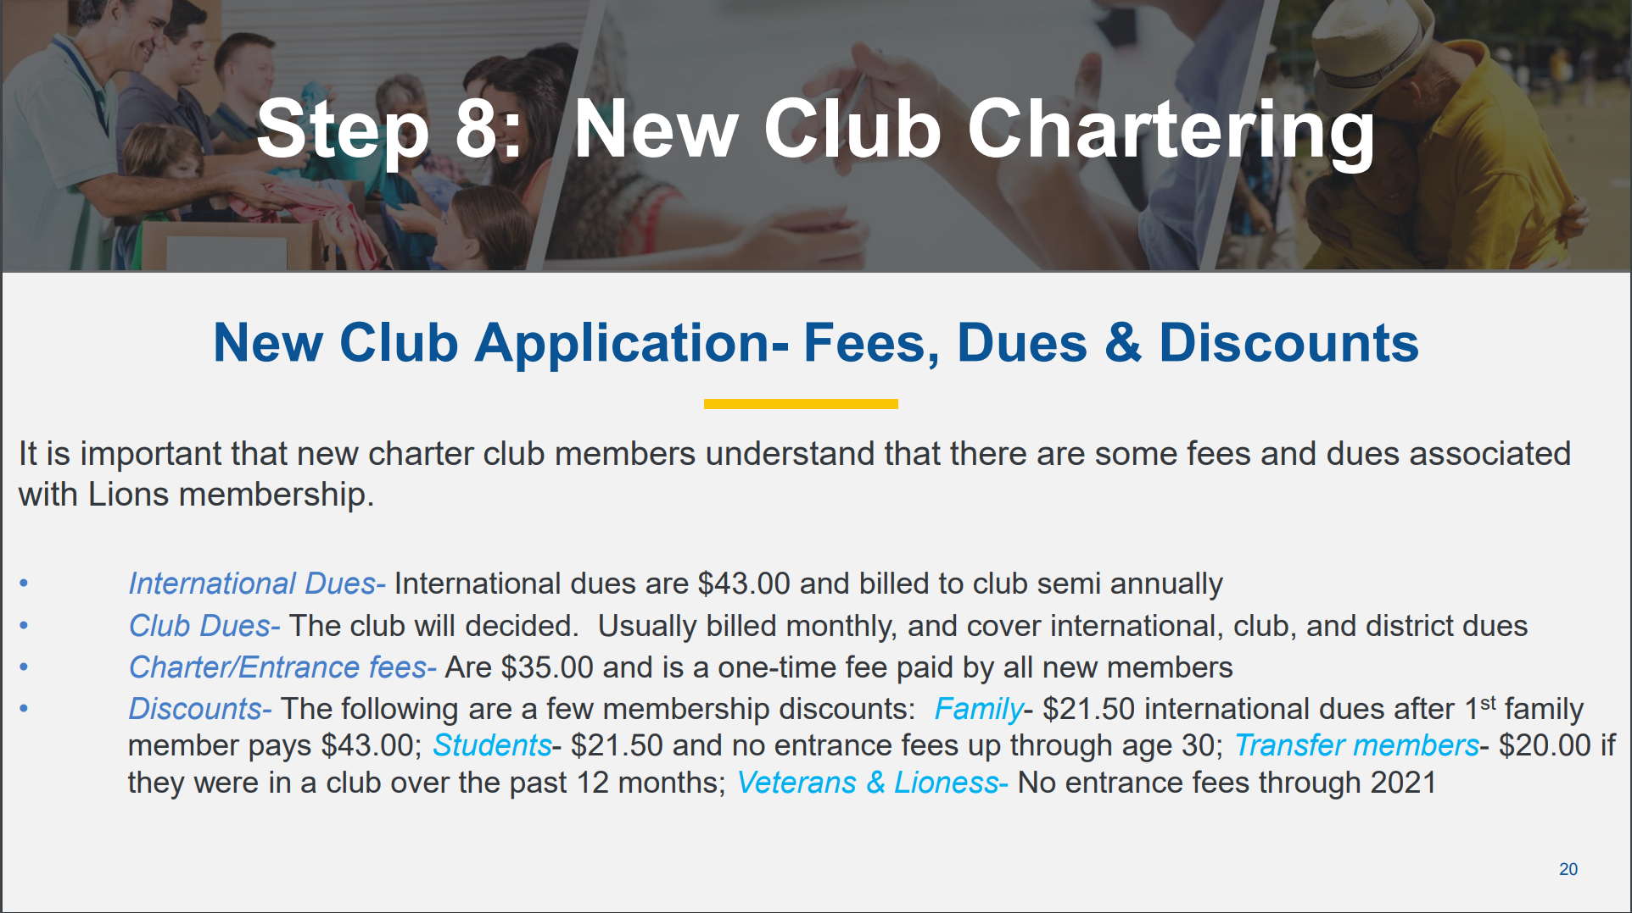
Notes:
Take special care to orient the new Lions to the financial obligations of membership. At present, and through June 30, 2021, the new member application fee of $35 is waived. This should help close the deal with some of your prospects, and make new club development a little easier.

Slide 21
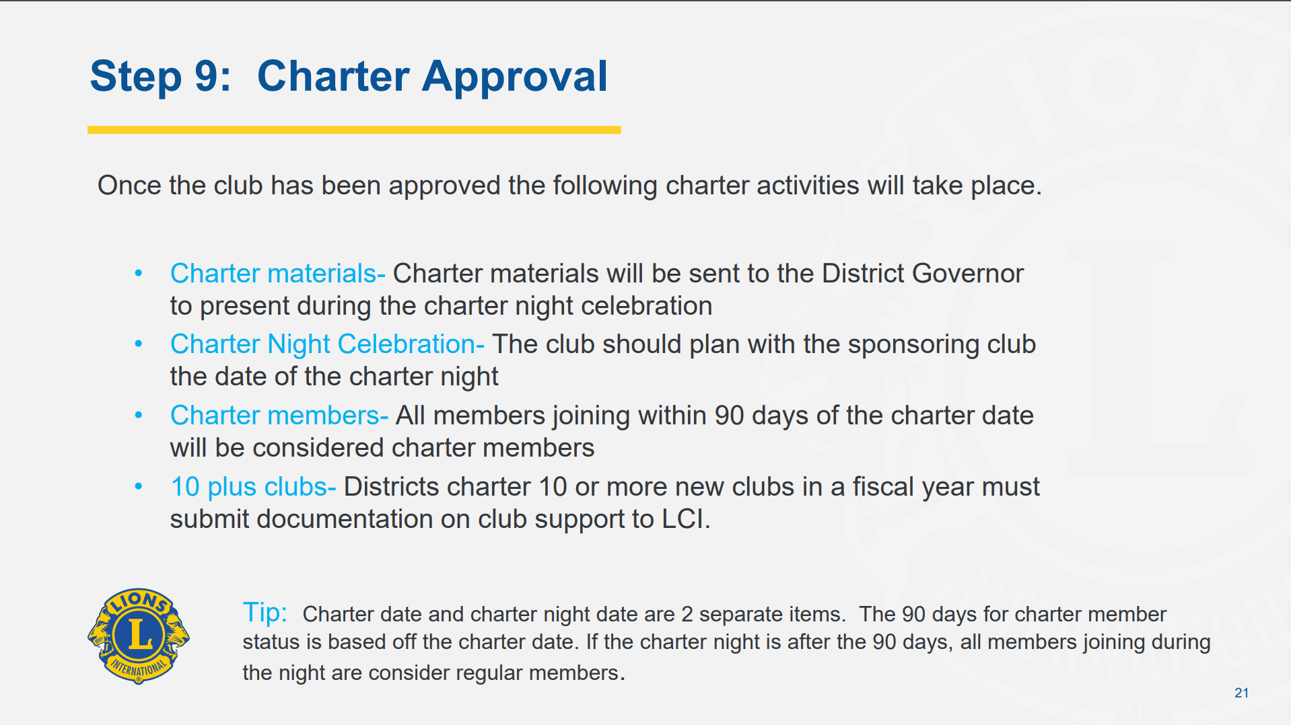
Notes:
Once all the needed information has been uploaded in the New Club Application on-line, LCI staff reviews the application and grants approval.
The New Club Charter kit is mailed to the District Governor.
Very Important for “Charter” Membership – special “Charter Member” designation is provided only to those Lions who join during the extension process, or up to 90 days after the official approval, or “Charter Date has been given by LCI.

Slide 22
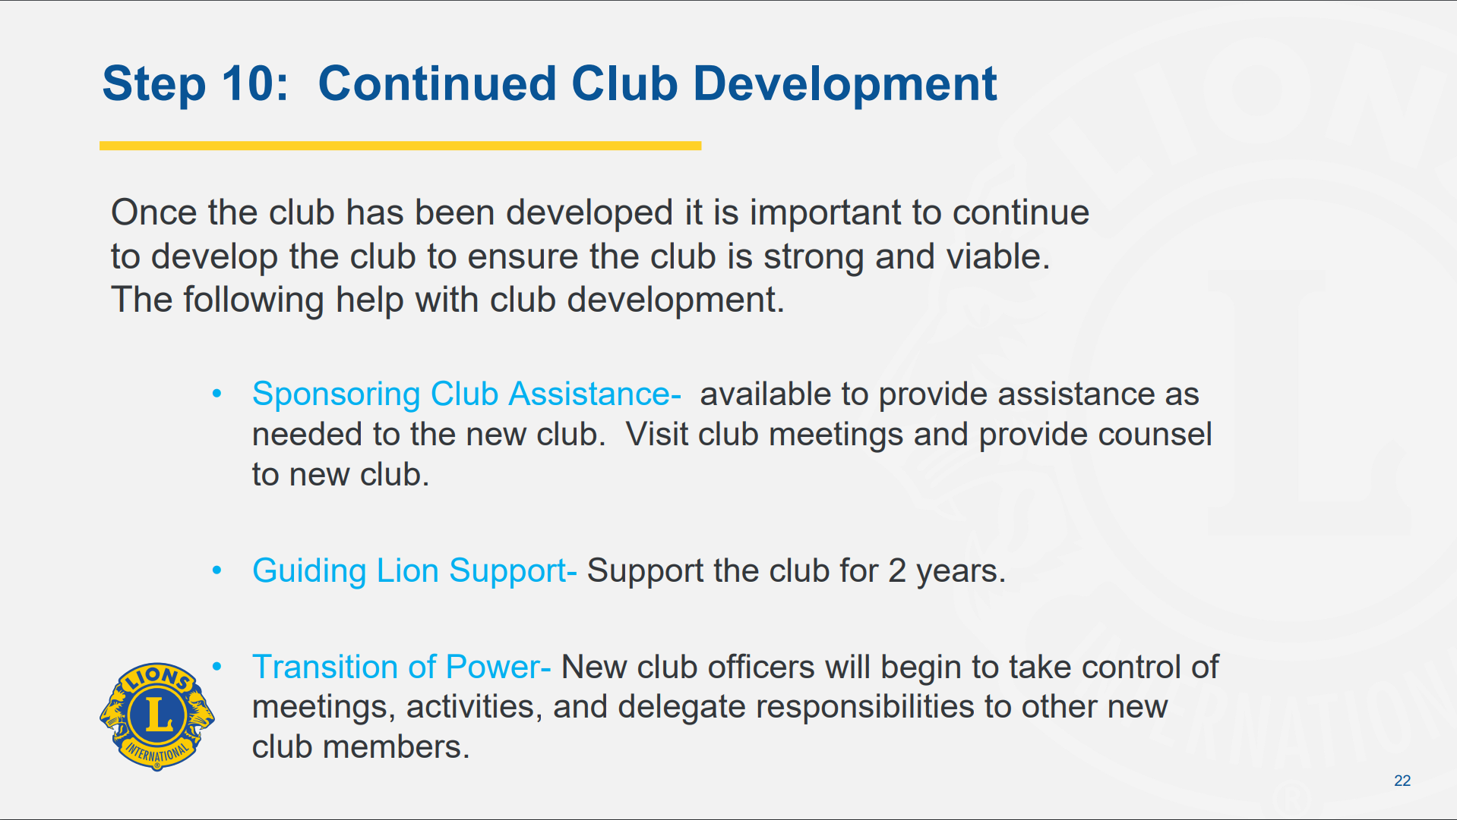
Notes:
Successful chartering does not end when the charter application is approved.
The new club will need support and guidance for at least a couple of years – maybe longer for some clubs.
** Consider how your District bills new Clubs for dues and charity contributions **
Are you sending statements to new clubs without clearly informing them what to expect?
For Lions charities and 100%’s – have the new Lions been properly educated on why these charities are important to our Association? Remember, we sold them on “Your Club, Your Way”. Don’t tell them now that they have chartered that they HAVE to support organizations and charities they know little, or nothing about. How long were you a Lion before you truly understood how important LeaderDogs, your local eye bank, of even the Texas Lions Camp is to our mission. Prioritize a visit from one of the Elected Directors so the members learn to appreciate the value of these charities to our Lions.

Slide 23
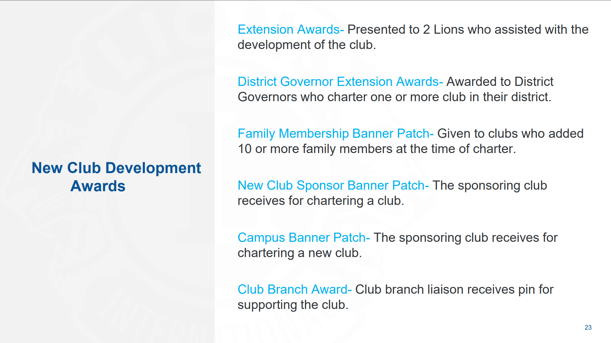
Notes:
Not that Lions do anything for awards or recognition, but it is important to understand what is available for Lions who take on the Extension Challenge and perform the exceptional work needed to grow and expand Lions’ reach through service.

Slide 24

Notes:
There are a number of resources available to Lions interested in participating, or leading Extension projects.

Slide 25
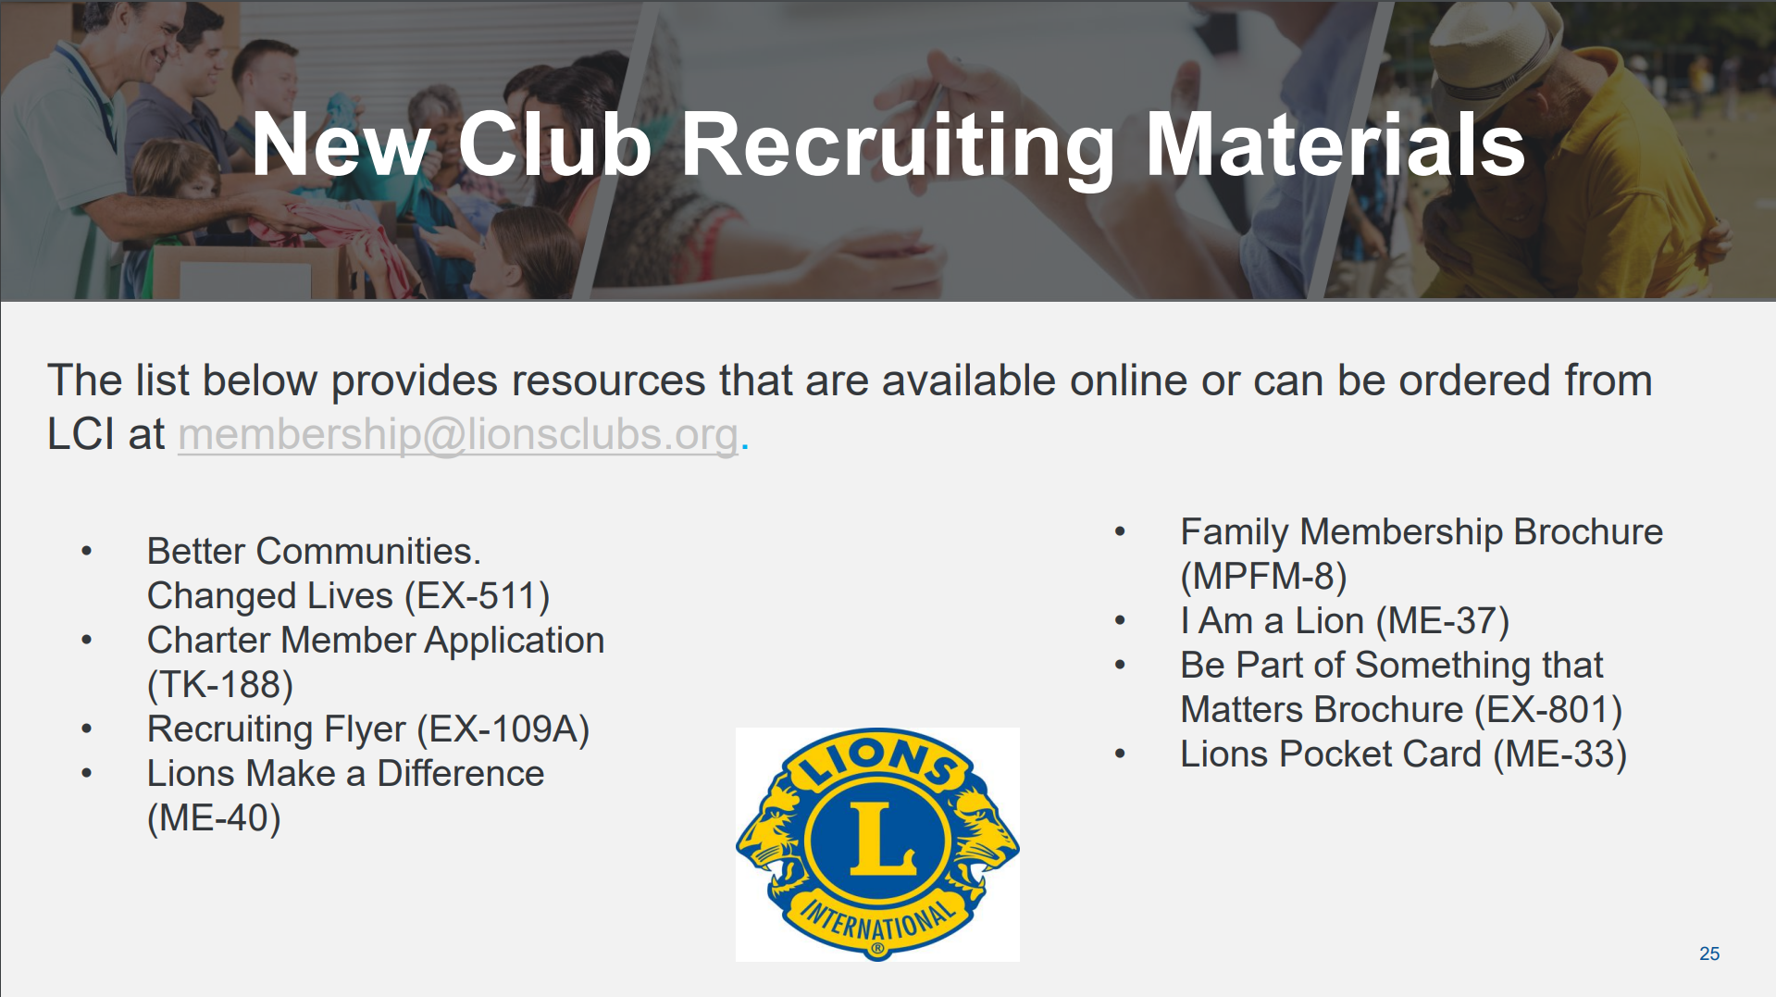
Notes:
Plan ahead. Order adequate supplies in advance to help your Extension Team prepare for the work of spreading Lionism. The District Governor should start the year with an ample supply of Charter Member Applications and Lions informational brochures.

Slide 26

PDG Mark W. Roth
MD2 – GMT Coordinator
MarkWRoth@aol.com
713.962.4194
Notes:
For more information, you can contact the New Clubs Department at (630) 571-1234 or by email at membership@lionsclubs.org

