Slide 1


Engagement:
The Key to Retaining Members
Notes:
Engagement is the key to member satisfaction. A high level of member engagement will translate into stronger member retention. So today, we will talk about ways to get and keep members engaged in the Club.

Slide 2


Objectives
Understand what motivates volunteers to join a Lions Club
Know where to look for support, tools and ideas to help engage your members
See how service can motivate your members
Know how to connect and motivate your members
Notes:
The goal of this presentation will be to help you understand
what motivates volunteers to join clubs,
where to find LCI materials to help you keep members motivated and engaged
how service can be a motivator, and
when to use certain tools to engage your members

Slide 3

To Make A Difference, To Serve
To Identify with a Cause or Project
To Be with Friends
To Increase Professional Development
To Network
Notes:
There are many reasons why people chose to join a Lions Club
The want to make a difference
They are passionate about a specific cause
They are social
The want to develop skills that translate in the workplace
The network with others
It is important to recognize what drives our members away, too – Conflicts, not making a difference, no sense of belonging, little recognition or appreciation and others

Slide 4

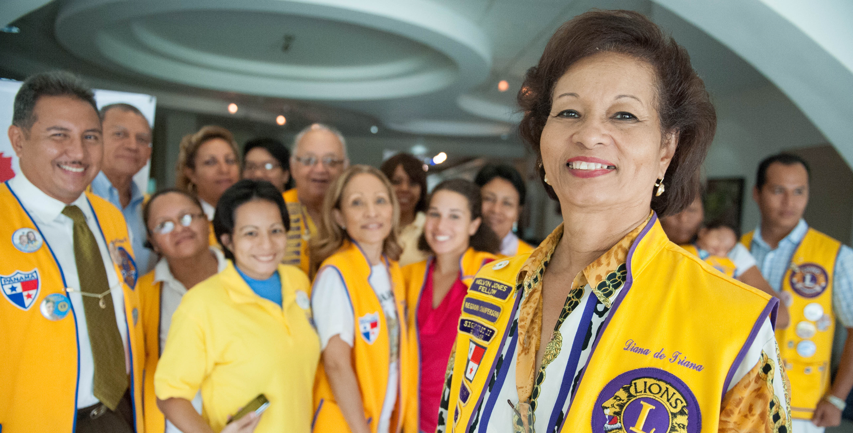

Engaged and fulfilled members
Your club must decide what is more important:
  100% Attendance or 100% Service
Then sell the product that you are going to deliver.
Remember…engaged Lions are:
  Eager and enthusiastic
  Enjoying fellowship and friendship
  Feeling respected and welcome
  Confident and proud of their clubs’ service
Notes:
Find your Clubs’ identity – Attendance v. Service. Discuss this with your members so you identify what you need to do to get where you all want to be.
Know which is more important – serving or attending meetings → what is important to the Club, then that is where you need to focus. These are the attributes of engaged, satisfied Lions – those at less risk of attrition
Eager and enthusiastic
Enjoying fellowship
Respect and appreciation
Proud of service

Slide 5
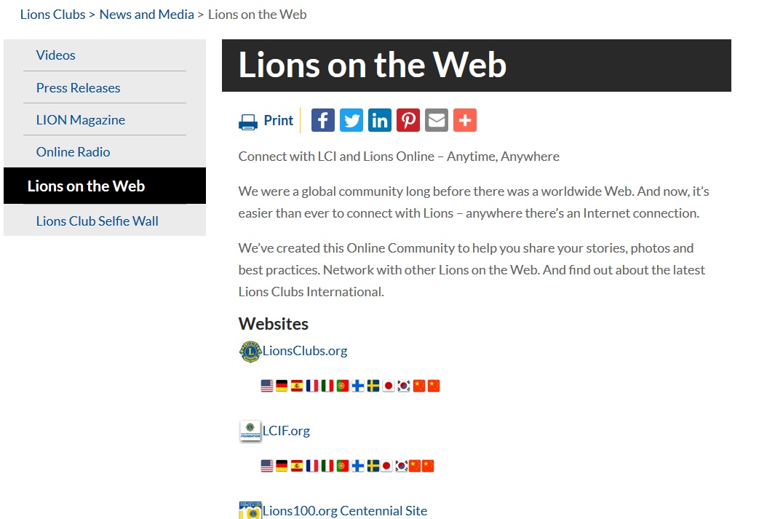
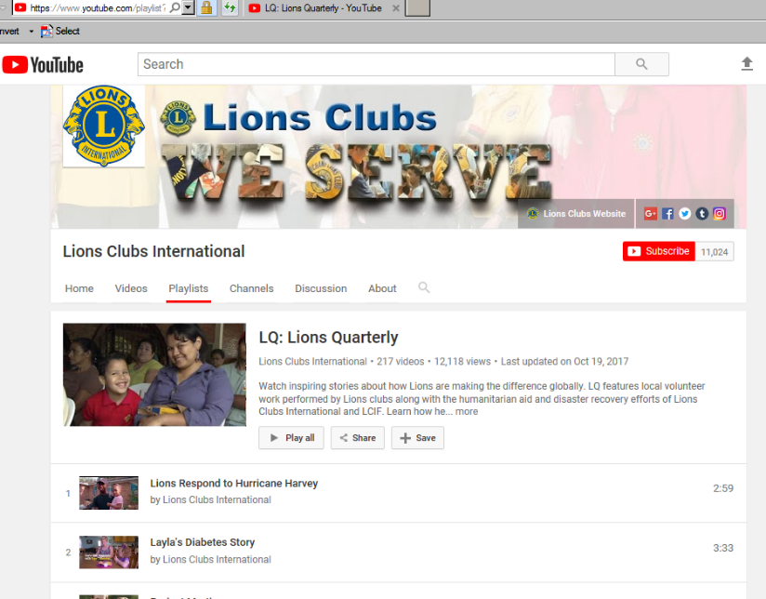
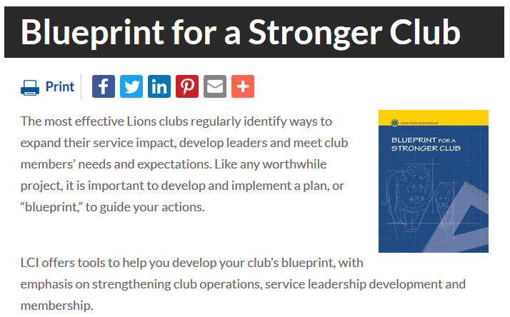

Preparing to Engage New Volunteers
Prior to inviting others to join our club, we need to truly evaluate it, such as the satisfaction of current members and our accomplishments and goals.
Available Tools
Membership Satisfaction Guide
Blueprint for a Stronger Club
Club Quality Initiative (CQI)
Your Club, Your Way!
LCI YouTube Channel LQ Videos
LionsClubs.org/nami
Notes:
As you plan to improve your Club’s level of connection or engagement, consider the resources from LCI
Member Satisfaction Survey
Blueprint for a Stronger Club
Club Quality Initiative
You Club, Your Way
NAMI Resources
Explore the leadership, membership and service materials on-line.

Slide 6

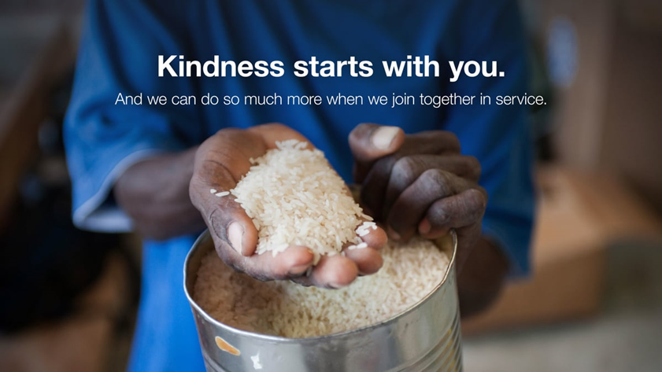
Updating Your Club by
Serving in New Ways
Community Needs Assessment –
Evaluate current projects.
Consider new ones.
Make a list of service provided in last 18 months.
Set “Service Impact Goals” for the next 6-12 months.
Notes:
The Community Needs Assessment will help you better understand the changing needs in your community. If you find new areas to serve, you will encounter new friends and new potential members.
Look at how you are currently serving in your community – are there opportunities to work in new areas – that will build excitement and keep your Service Profile fresh

Slide 7
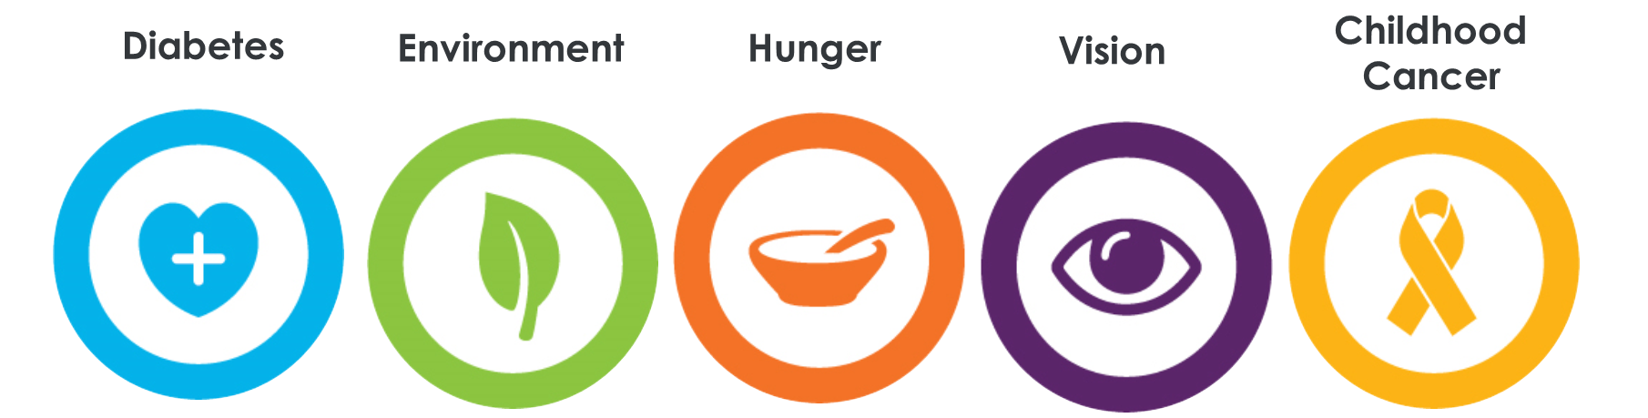

How is your Club serving?
Lead with Service
Where there’s a need, there’s a Lion.
Global Causes: Enhancing service impact and focus on contributing to the LCI Forward goal of serving 200 million people per year by 2020-21.
Low Cost, High Visibility and High Impact
It costs nothing but time to serve others …
Notes:
The Centennial Service Challenge provided 4 pillars of service to help Clubs identify new areas for their members to engage in service. Numerous resources were created to help your club reach these new opportunities.
After the Centennial, LCI added Diabetes as a service focus and provided additional materials to learn how clubs could serve in this important area.

Slide 8
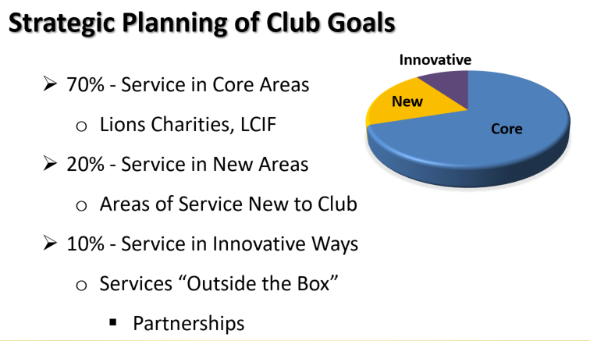

Think Outside the Box
Challenge and Encourage
Challenge Lions to consider new projects.
Encourage Lions to be innovative.
The Pandemic motivates us to find new ways to deliver service
The “70-20-10” Rule
Notes:
One of the easiest ways to get your members engaged is to ask for their input.
Ask your members for ideas for the Club to consider.
Service is service – the only change we have in this pandemic is to find our ‘means” for delivering service.
Consider the “70-20-10” Rule for setting your Club’s Service projects – where 10% of your service might be in truly creative ways for your Club

Slide 9



Innovative & Creative
Service Ideas
Know your Members’ interests
Member suggestions
Involve members on service committees
Encourage non-Traditional service ideas
Promote your service
Notes:
In looking for areas to serve – ASK your members.
Encourage them to reach outside the comfort-zone – look for new opportunities
Look at partnering with other groups to reach new areas and serve in new ways

Slide 10
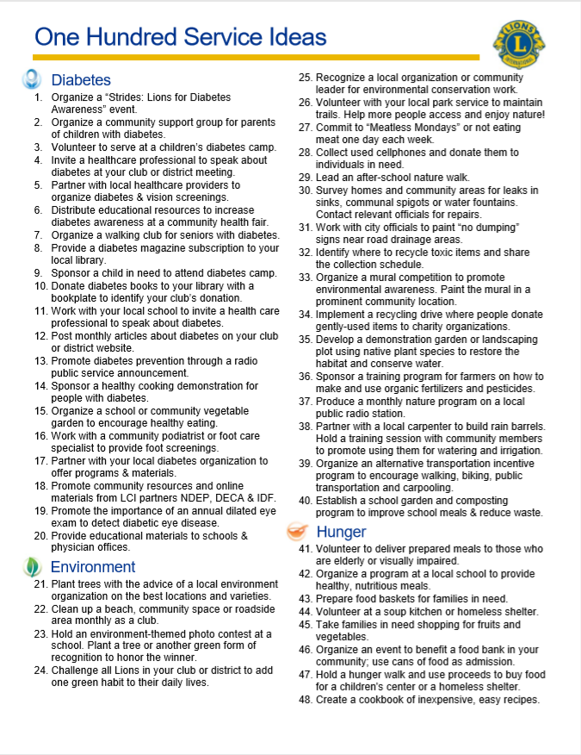
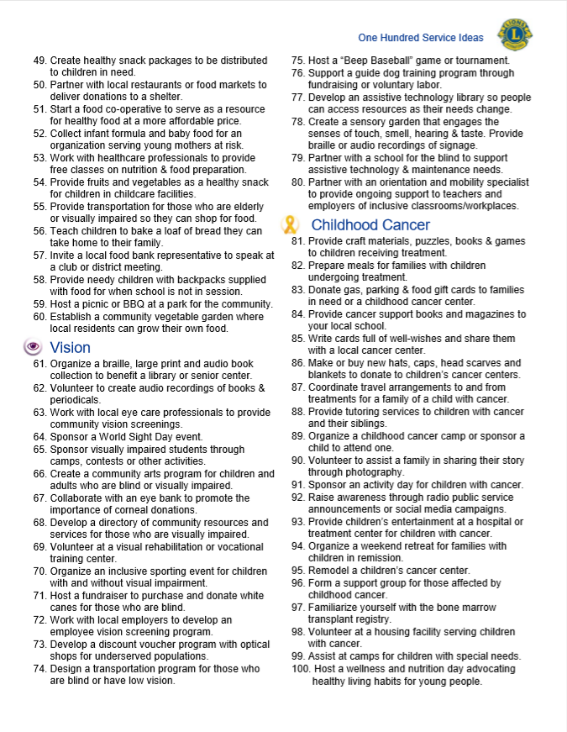

100 Service Ideas
Find a Project:
  Consider members’ abilities and limitations
  Consider your community’s restrictions
  Partner with others providing service
Pick a service project that best meets your club’s abilities – get your members serving others
Notes:
Last year, the North American Membership Initiative compiled a list of “100 Service Ideas” to help clubs struggling to get ideas for new service projects.
You don’t have to build a health clinic – not every club can do that. But there IS a service project just right for your club.
Not every Lion is shut-in and avoiding human contact – many are rolling up their sleeves and serving on the front line. BUT, many are severely limiting their interaction with others. There are projects appropriate for everyone.
Feeding the homeless – some Lions will work the service line; others might just pick up/drop off food supplies
Reading to a nursing home resident or blind person over the phone
Phone Tree Chair – calling members, wellness check calling on the elderly, etc.

Slide 11

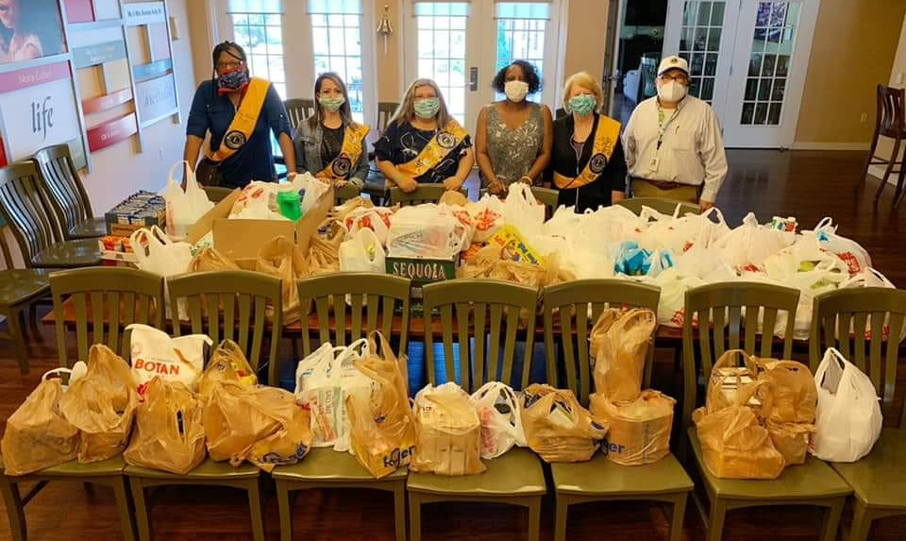
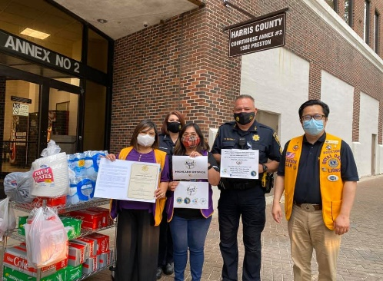
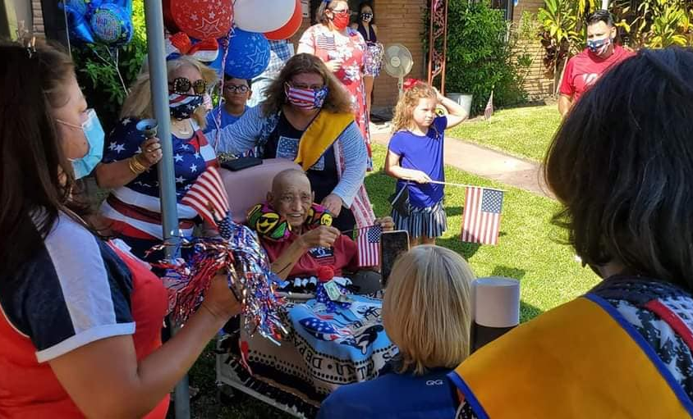
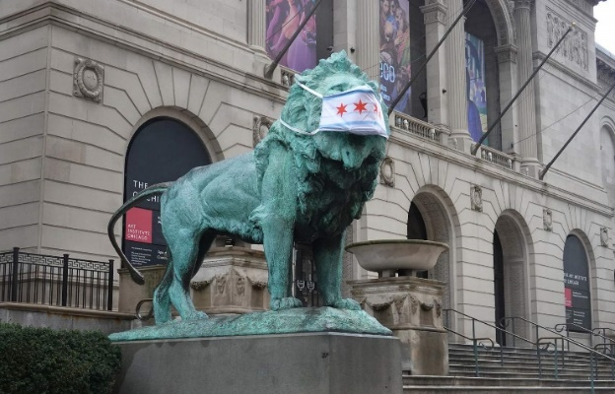

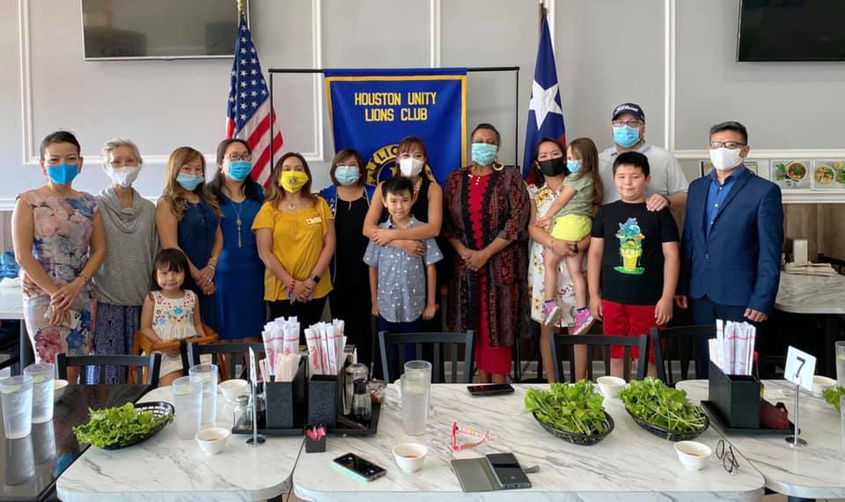
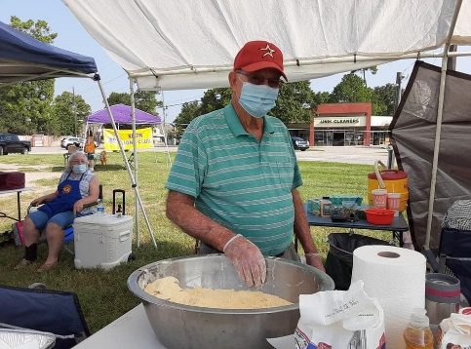
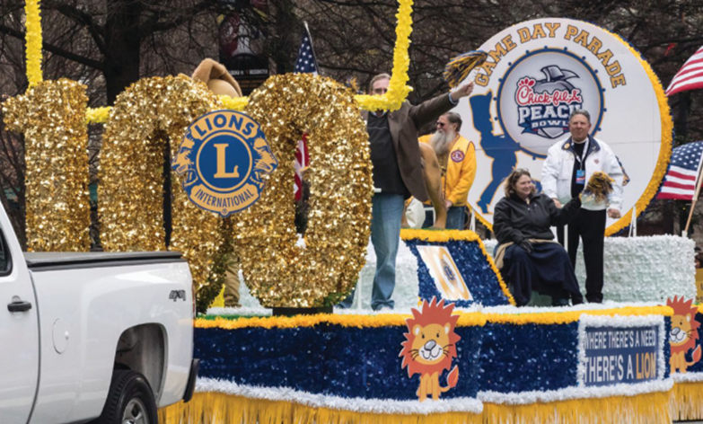
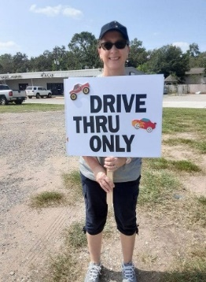
The Pandemic Forces Creativity!
Notes:
Lions are serving everywhere …. Despite the pandemic
Food deliveries to nonprofit homes
Honoring an elderly veteran with a drive-by parade on his street
A drive-by Catfish fry fundraiser
Tree planting
Neighborhood or park clean up

Slide 12
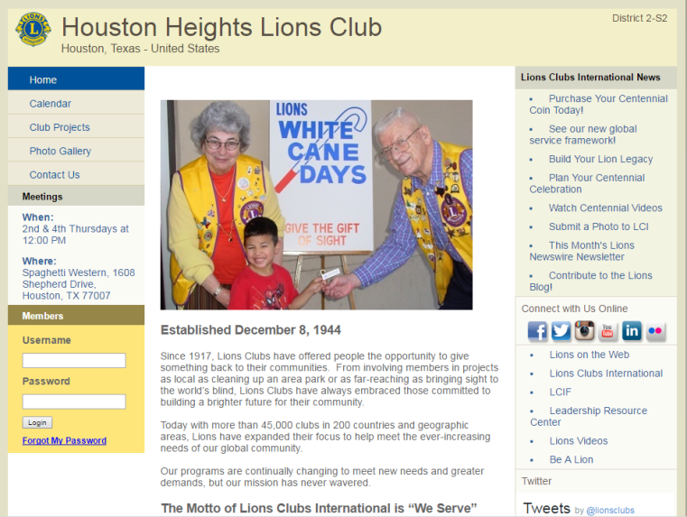



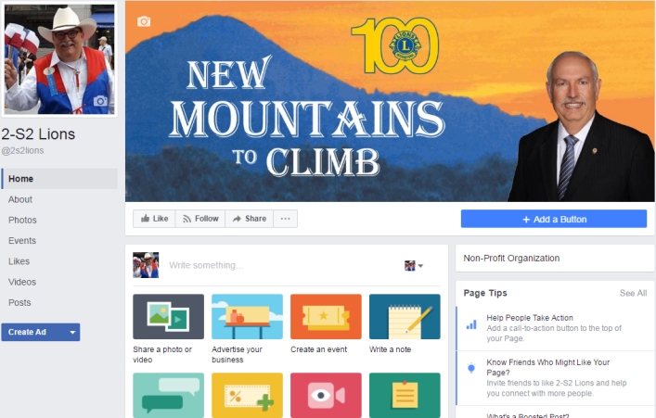





Social Media
Connect with Your Community
Web & Media Presence
Notes:
Communication is critical – since we may not be meeting regularly – Communicate with your community so they know what you are doing and may be available to help with their needs. Consider pulling a committee together to work on your Club’s social media presence.

Slide 13
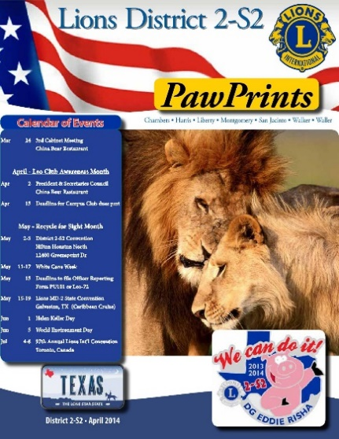
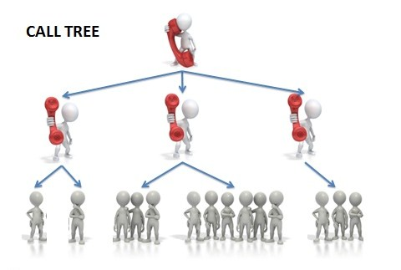
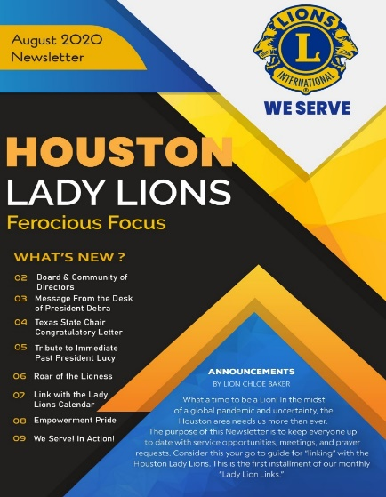
Talk to your Lions
Communicate with Your Members
Keep members informed
Newsletters, Bulletins & eMail
Don’t wait till the member drops to reach out
Notes:
Communicate with your members – keep them connected to the Club. Consider setting up a call tree to ensure that each member receives a “wellness” call at least monthly, If you don’t already have a District or Club Newsletter, consider putting one together. Not just informational to keep members updated on what is happening in your Club, it also lets them know that the Club cares about them.

Slide 14

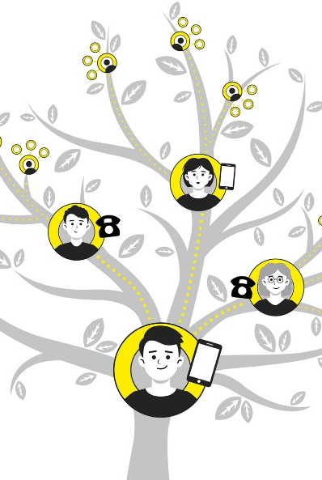
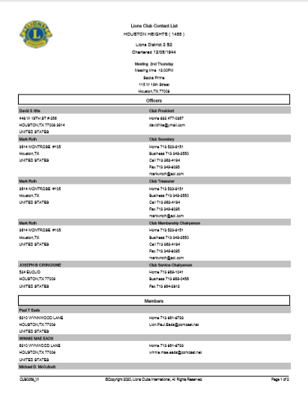

Update Contact Information
Notes:
Take the opportunity to update your Club’s member information. Make sure that all your members have a current roster of member information

Slide 15
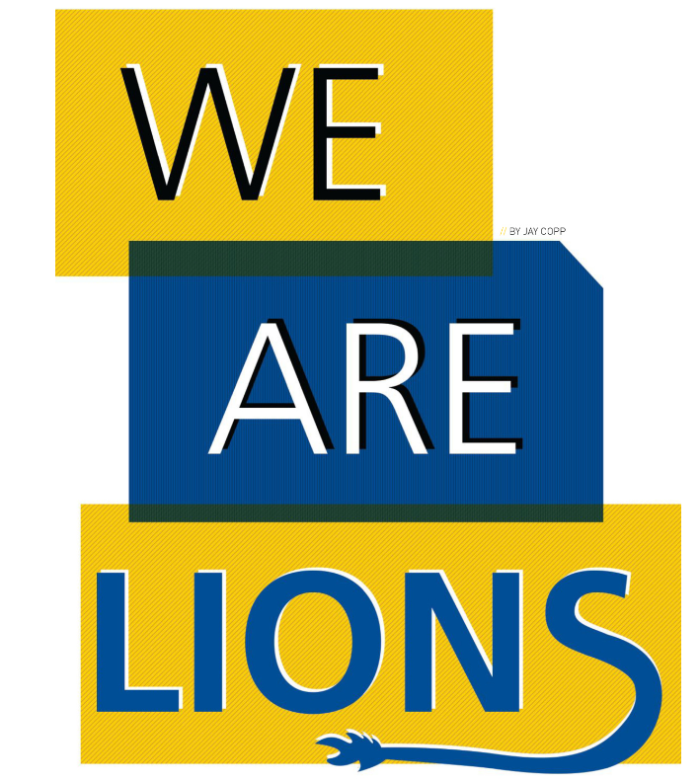
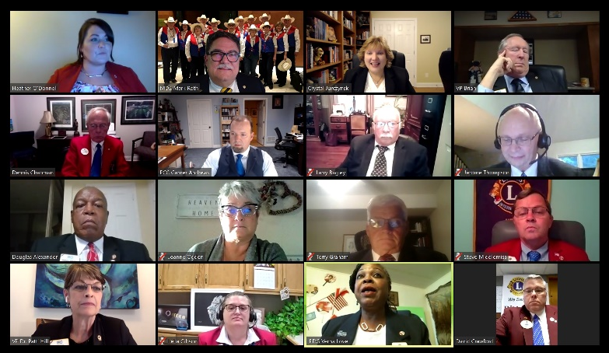

Video Meetings
Notes:
Every challenge provides unique opportunities. With many clubs unable to hold in-person meetings, ZOOM and Go-To-Meeting formats for meetings have kept us connected. If your Club is not meeting at all, reach out to your District leadership. They can help facilitate a zoom meeting for your club.

Slide 16

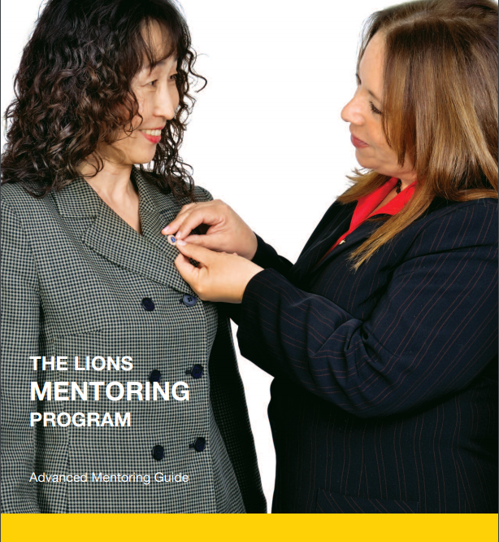

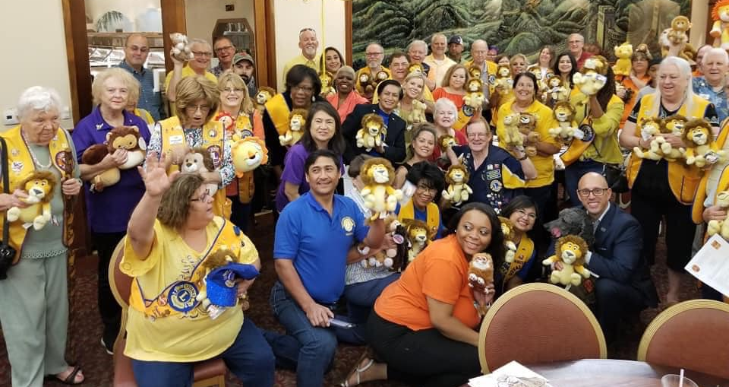
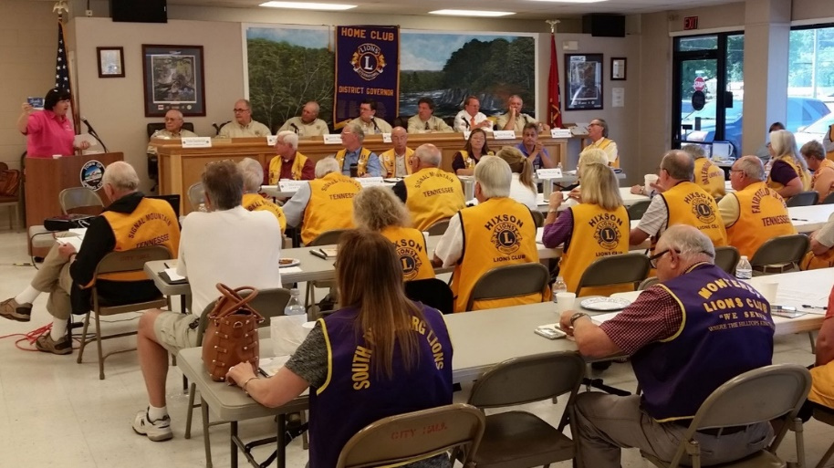
Include Your Members
Zone, District and Cabinet Meetings – Mentoring Program
Notes:
Include ALL your members in the meetings in and around your District – Cabinet and Zoom meetings, Leadership Institutes and others. Provide education on all aspects of Lionism via Zoom and in-person.
Download the Mentoring Program materials from LCI and develop some mentors in your Club

Slide 17

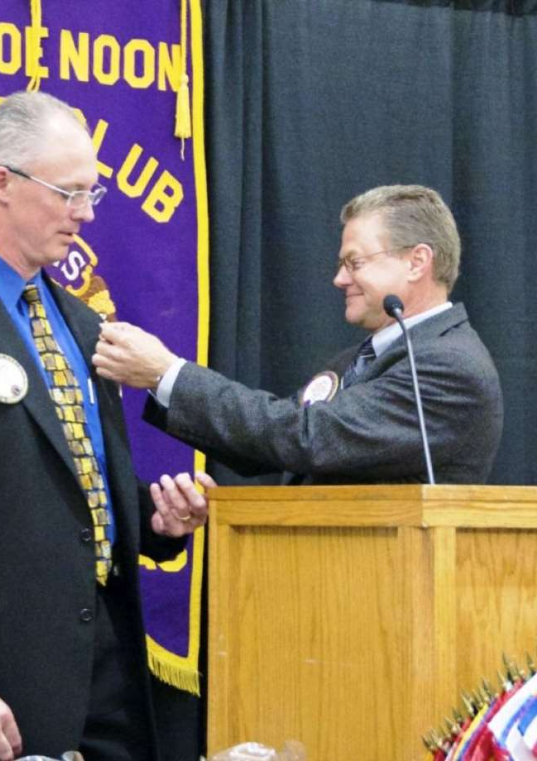
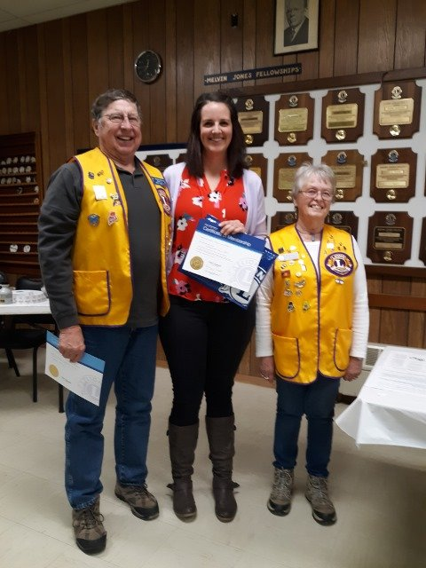
Make Every Event Special
New Member Induction and Orientation,
Officer Installation, and other special events
Notes:
Whatever event you are conducting – remember to make them special. Don’t let the pandemic spoil the opportunity to make your members feel special. There are many safe ways to accomplish that.

Slide 18

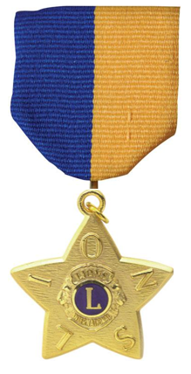
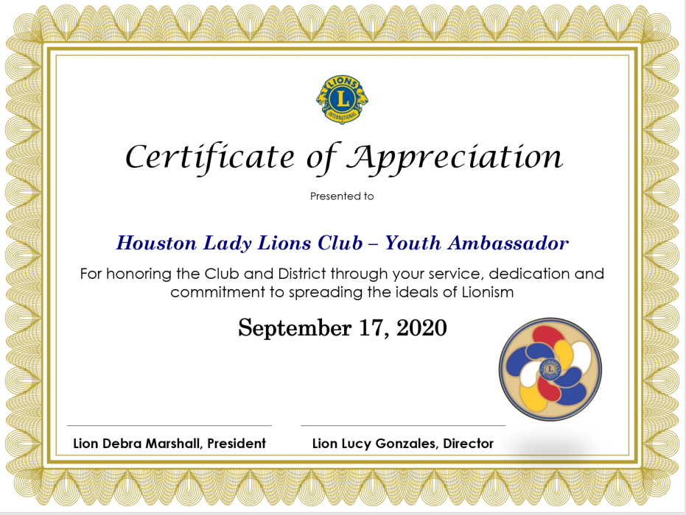

Recognize Outstanding Lions
Committee Members, Chairs and Participants – others
Notes:
Don’t forget to find ways to show your Club’s appreciation for a job well done. No one serves for the recognition, but it is really nice when someone, or the club, takes the time to tell a member how important they are to the work of Lions. Templates are available to help you design an appropriate certificate of recognition. Plaques, pins, medals and other recognition items can be purchased through the LCI Shop.

Slide 19

Summary: Engaged Members Thrive
Every Lion is motivated to serve – their way!
LCI has tools to help with engagement
Service drives member satisfaction
Connect with your Community
Communicate with your Members
Make events special
Support new (and seasoned) Lions
Recognize & Appreciate Lions
Notes:
We are all Lions because we love to serve others
LCI can help clubs find new ways to enhance member satisfaction and re-engage your members
Remember that service drives membership, and more members means more service opportunities
Keep connected with your members and your community
Take the opportunity to make your events, service and activities memorable
Utilize the mentoring programs to provide member support early, before they disengage from the club
Lastly, don’t forget to say thank you, and honor your hard working Lions who lead the way through service

Slide 20
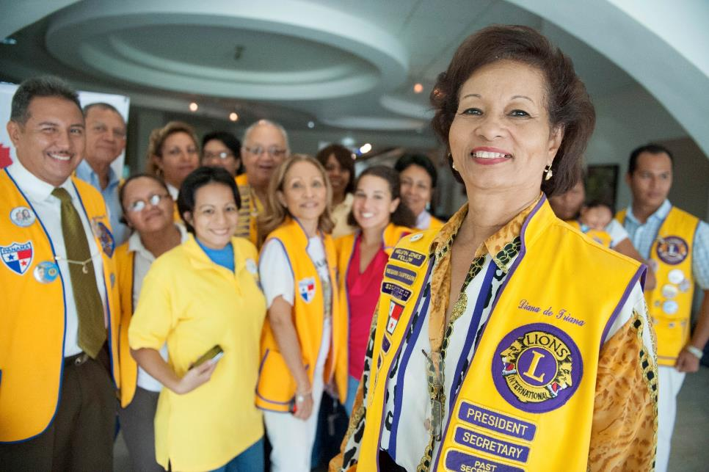
Thank you
PDG Mark W. Roth
MD2 – GMT Coordinator
MarkWRoth@aol.com
713.962.4194

