Slide 1

Serving in a Pandemic
While Keeping Members
Safe & Engaged
Presented by
PDG Mark W. Roth, MD-2 GMT Coordinator
MarkWRoth@aol.com
Notes:
While no community is currently in a state of complete lockdown, there are communities with restrictions that impact Lions’ ability to reach the community.
It is understandable that many Lions Clubs are struggling to find ways to conduct meaningful service
We are going to talk today about keeping Lions’ service alive – even in the throws of a Pandemic

Slide 2
Objectives
One
Know that your Club can still serve others while keeping members safe from exposure
Two
Identify service opportunities that best fit your Club
Three
Select the right service projects for each member of the Club
Notes:
By the end of this presentation, you will better understand how some clubs have adapted to serve others
You will explore ways to find new opportunities to fill needs in your community
You will be able to look critically at your Lions Club and weigh your own concerns to successfully identify appropriate service project opportunities

Slide 3
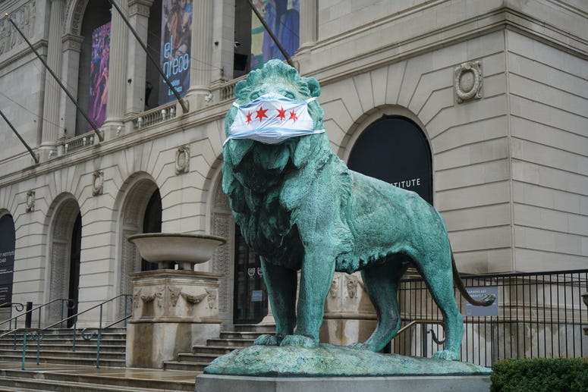
?
Personal Safety
How can my fellow Lions stay safe?
Social Distancing & Personal Protective Equipment
Know and Follow Local Guidelines
Assess each members’ comfort level for “exposure”
Divide up tasks based on comfort level and risk
Notes:
Safety Comes First!
Make sure your members have access to the Personal Protective Equipment appropriate to the level of exposure you and your members are comfortable accepting
Know the community guidelines in existence – remember, these can change quickly as the impact of the pandemic changes
Not every Lion has the same risk – old vs. young, pre-existing conditions, etc. – ASK your members IF and HOW they feel comfortable serving
The divide the duties to align with the preferences of your members

Slide 4
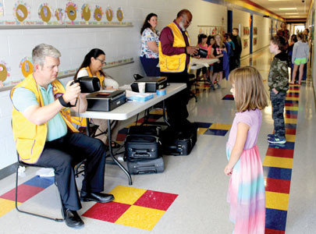
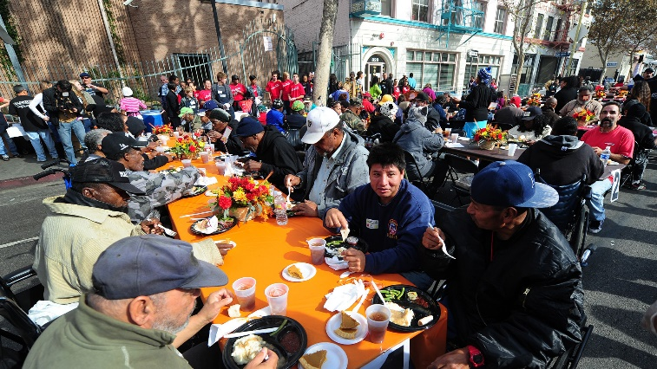
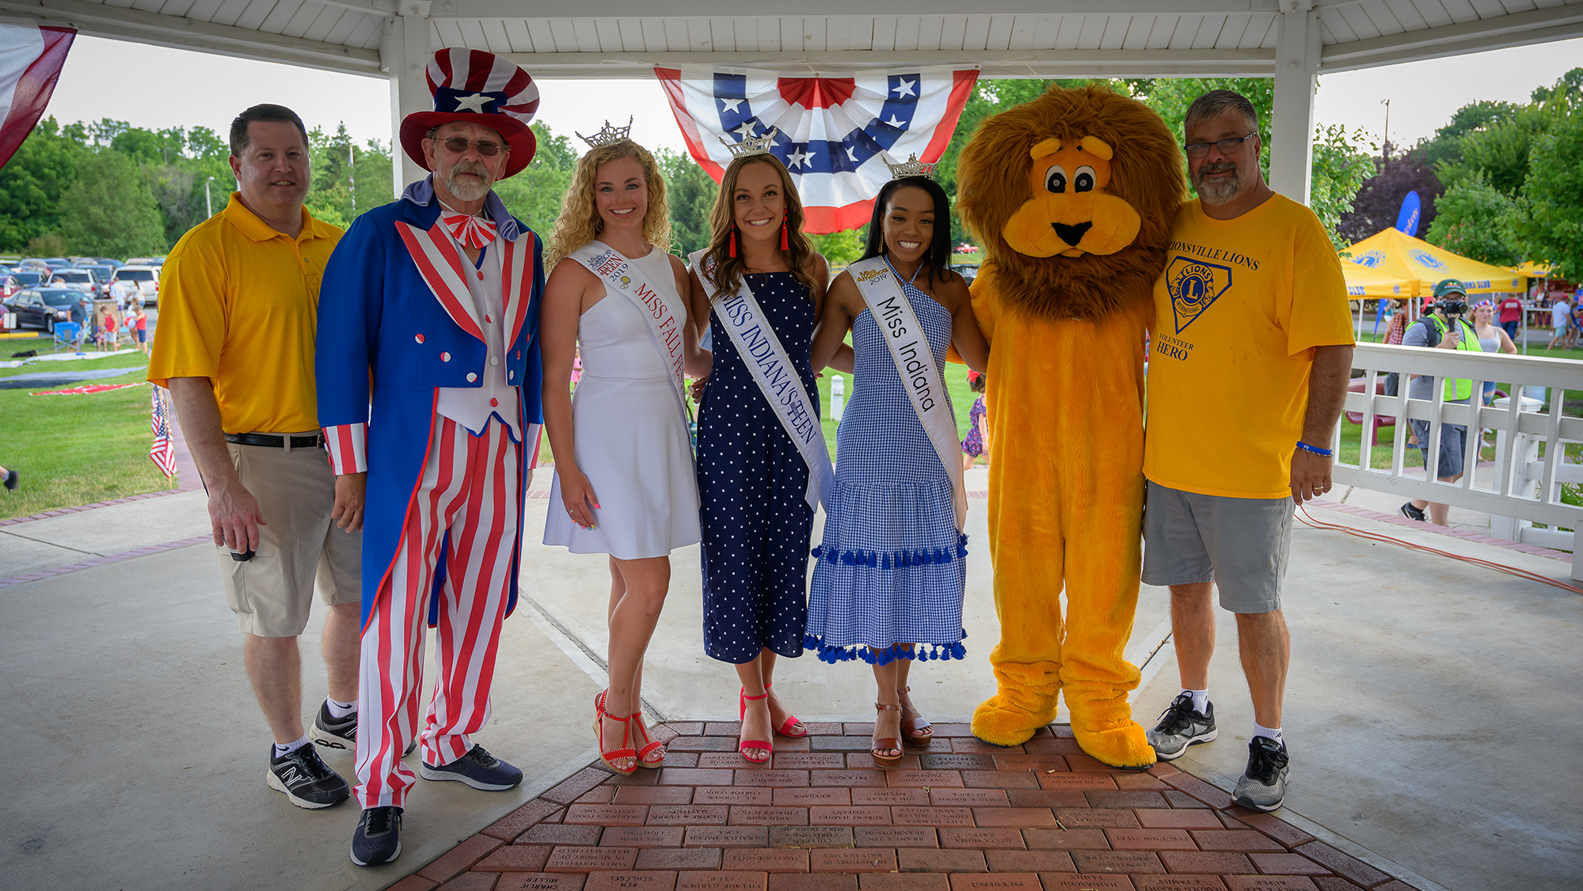
Service Delivery Challenge
Old Methods may not be appropriate
Vision Screening
Feeding the Homeless
Lions Club Carnival
Notes:
Service isn’t static – it changes over time
Needs change – services become obsolete, and Lions need a “freshness” to remain engaged. Always be looking for something new to do – a new need to fill, or a new project to undertake
Even where existing service is still needed, the way we provide that service may need to change or be adapted to fall within acceptable community guidelines. The old way of doing hands-on service has had to adapt – LOOK for ways to continue to deliver the service you traditionally provide

Slide 5

Member Preferences
Lions can serve at different levels
Project Planning
Telephone Coordinator
Supplies and Purchasing
Media and Promotion
Service Delivery
Follow-up
Report your Service - MyLion
Notes:
Planning service in the age of Covid leads us to look more closely at all that goes into planning a service project.
Maybe you, or one of your fellow Lions is comfortable donning protective clothing and serving on the front line in health fairs or food service.
Perhaps, you prefer more limited exposure to others outside your immediate family.
Remember, there is always a role for everyone in a Lions service project

Slide 6
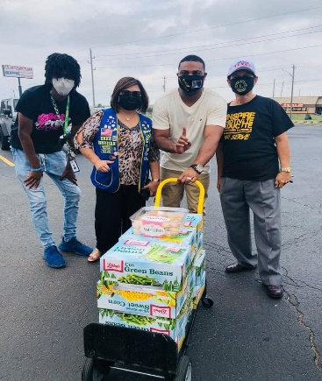
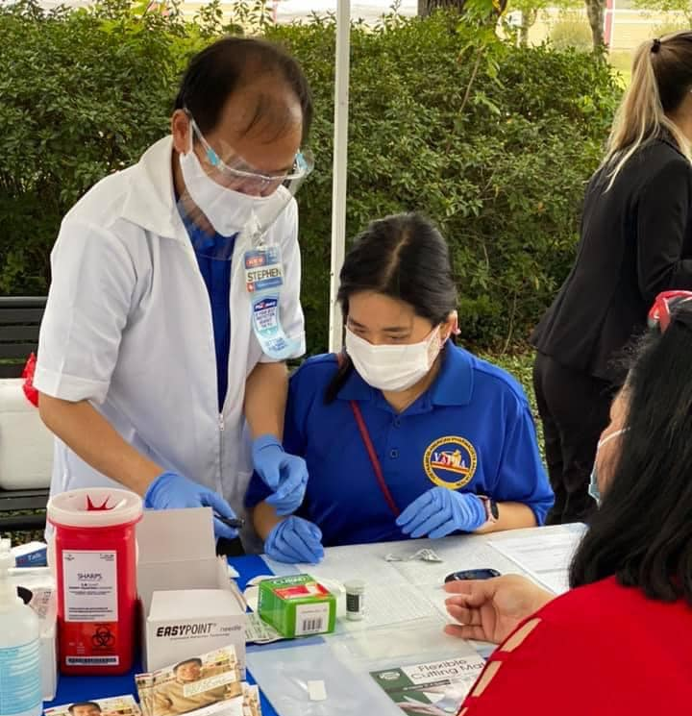
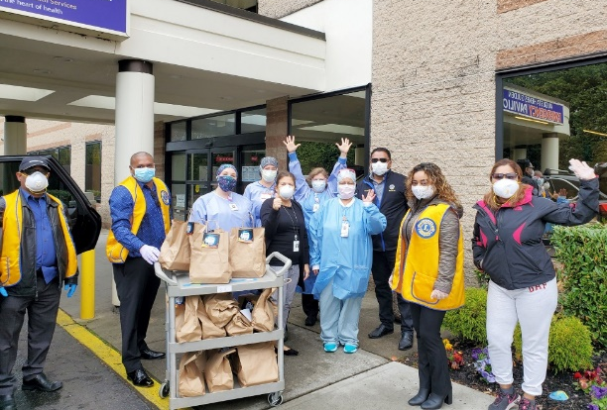

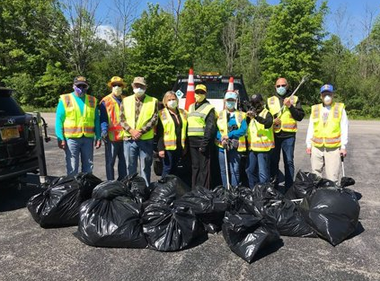
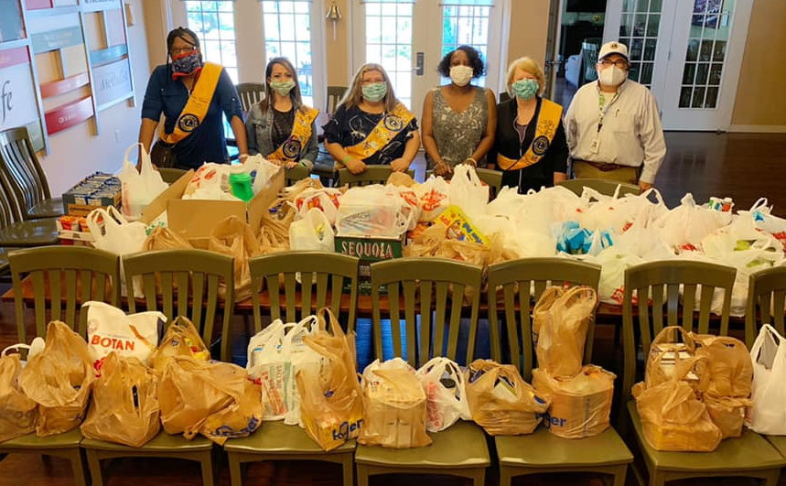
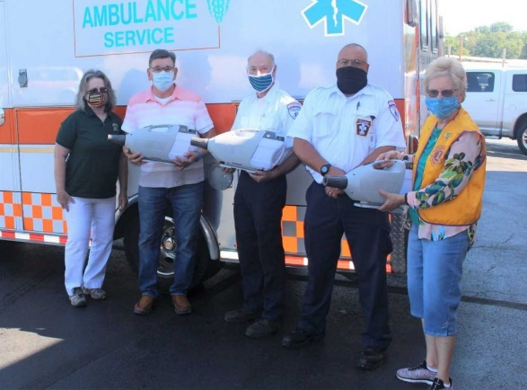
2020 Service Examples
Lions are serving everywhere!
Notes:
Lions concerned with personal exposure may serve by delivering products from one point to another – popping the trunk to pick up and deliver supplies
Lions are serving outside – performing in neighborhood clean-up projects, or delivering supplies to foodbanks or meals and PPE to front-line workers
Lions are reaching out to nursing homes and sending greeting cars to residents. They are picking up groceries and medicines to deliver to shut-ins.
Some Lions are learning how to create taping for the blind and visually impaired.

Slide 7
Starting Point
What are Lions willing and able to do?
Assess members “comfort level” for participating in public service during the Pandemic
Encourage members to share ideas on community needs they feel are appropriate for the Club
Explore “partnership” relationships with other organizations serving
Notes:
Don’t shame anyone for their lack of eagerness right now to engage in service – many are afraid and get mixed messages from local officials and the media.
Instead, ask the members for suggestions on the amount of exposure they would be comfortable accepting.
Ask your members to consider calling local officials and service agencies to identify needed service or learn about opportunities to assist others . One allied service agency providing meal service for the homeless may just need someone to pick up food from a pantry or grocer and deliver it to the preparation site.

Slide 8
LCI Resources to Help
Match members with project needs
Club and member self-assessments
Community Needs Assessment
NoAMI SWOT Assessment tool
LCI Member Resources www.lionsclubs.org
Local media, Chamber of Commerce, Volunteer Board
Notes:
Clubs should continue to look at the community and identify the unmet needs that exist. As you look at community needs and match the task to the member profile for service they’re willing to perform, plan your projects.
LCI Has numerous resources available through the NoAMI resource page and elsewhere that can help you develop a plan to assess community needs, or to perform a Club self-assessment
There are other sources in your community where you can learn about community needs – business and community leaders are good places to start.

Slide 9

Alleviating Hunger
Major Pandemic-related Need
Examples
Some of our neighbors are having to choose between paying their bills, or feeding their families
Notes:
The pandemic has exacerbated the need to focus service on alleviating hunger.
We’ll use this LCI Service Initiative to highlight several different service examples and illustrate appropriate ways to engage Lions in the service project who may need to limit their exposure.

Slide 10
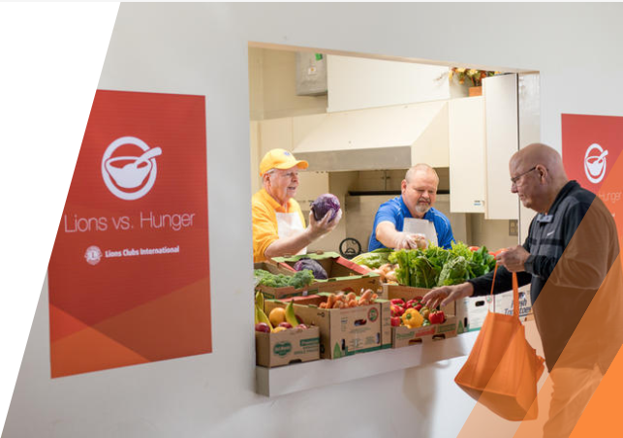
Develop Your Plan
Lions and Leos can feed our local communities.
Divide the tasks and match members with the tasks
Include promotional ideas and look at social media, as well as traditional forms of marketing
Notes:
After gathering information on the needs relative to alleviating hunger, put your idea down in a plan with action items.
Be sure to include details on the tasks involved – match them with your members’ abilities and limitations
Don’t overlook promotional opportunities to showcase your Club’s vital connection with the community
Your members who have reservations or concerns about being around gatherings of other volunteers might be better utilized in the planning and coordination tasks of the project. They would mostly work remotely and communicate by phone and email.

Slide 11
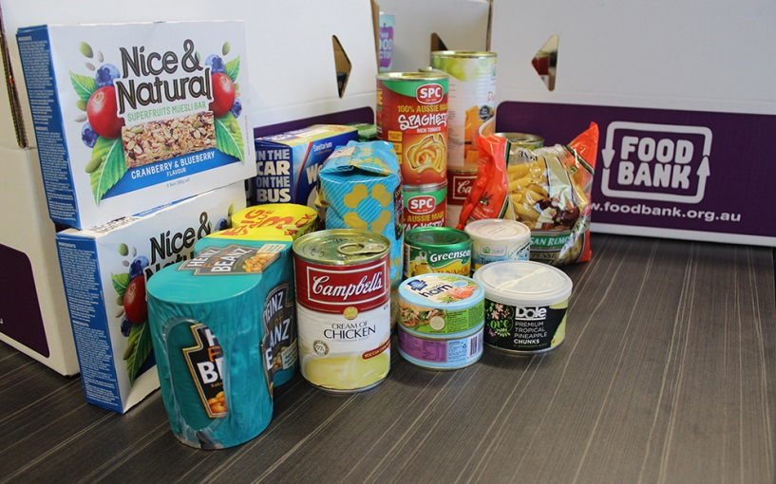
Food Collection Initiative
Conduct a food collection drive
Consider taking on a part of an existing program – collecting, sorting, packing and delivery
Explore Partnering with others
Local food banks and other public and private service organizations
Notes:
Simple projects can be a good start
A food collection drive affiliated with local food bank of pantry could be a start – one of the club members can serve as the pick-up or delivery person.
Are there others in the community willing to partner with you – perhaps a major grocer in the neighborhood
If the Lion wants to participate in the project but has concerns about interacting with the public, they could coordinate others by phone.
If the Lion wanted to get out and be a little more engaged in the project, then they might consider driving to places where collections are to occur. They could remain safely in their car, popping the trunk or lifting the tailgate remotely and asking the individual making the donations to just slide the supplies in the back.

Slide 12
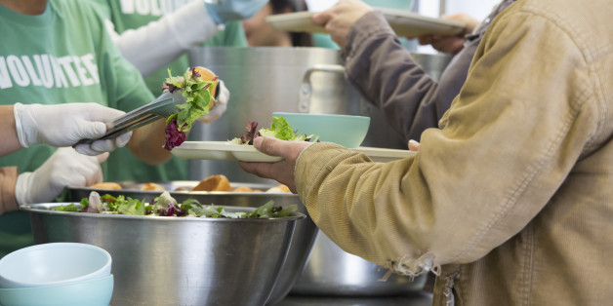
Direct Food Service
Your club can directly serve nutritious foods to hungry community members.
Notes:
Lions who may be younger, or less at-risk may be willing to serve food directly to the public.
If the club does not have the resources and cannot conduct the event on its own, maybe some of the members can participate as a volunteer in another organization’s big meal delivery.
Another possibility is for Lions to play a role in the logistics – just like the previous example, they could facilitate the delivery of goods while minimizing the contact with others.
Still, other Lions who may be home-bound might assist with the communication on the project or coordinate the promotion and PR activities.

Slide 13
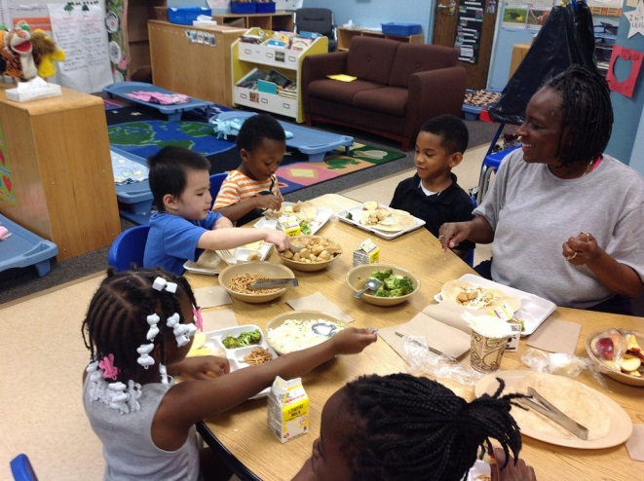
Children’s Nutritional Breakfast
Your club can pair an educational activity with a nutritious breakfast for elementary/primary school children.
Notes:
Serve treats to children while providing an educational event alongside an event where children receive food products
Given certain restrictions in local school districts, you need to challenge your club to be creative in looking for opportunities to support the children in your area
Look at the various tasks involved if this is a project your Club wants to consider. Then, break down the activities that go into it. Are there tasks that could be assumed by some Lions that provide greater exposure? Are there other tasks that do not – or have very limited exposure?
It is always a good idea, even in better times, to review all the activities that go into service projects.
An effective Club leader - or project Chair – actively looks for projects that can be conducted that will utilize as many of the skills and capabilities, and as many of the members as possible. This is the key down the road to retention – getting the members engaged.

Slide 14

Summer Child Nutrition Program
Twenty-two million children receive free or reduced-cost lunches during the school year, but during the summer months, only 3.9 million continue to have access to those subsidized meals.
Notes:
Summer will be here before you know it.
Many children being home-schooled for months might not have access to good nutrition.
Lions who traditionally provide dictionaries may pair those projects with a meal or food supplies.
Some Lions Clubs have partnered with local food banks to provide a mobile service that fills this need during the summer – NON=school months.
There are again, a number of behind-the-scene roles available for older, more at-risk members. One member is a Club might serve as the “designated” contact with the schools in the community. Their role might be checking in by phone or through email with the principals and/or school nurses. They could gather information about the needs in the school and among the children as they let out for the summer.

Slide 15
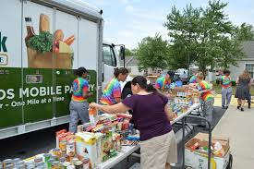
Mobile Pantry Program
Fast and flexible, a Mobile Pantry Program can serve many of the highest-need households — including families in significantly underserved or hard-to-reach areas.
Notes:
Partner with a food back and set up packages for families needing food assistance – you can make your club’s role hands-on, or in support of other groups serving on the front line.
Perhaps one of the roles that provides more limited exposure would be that of coordinating the communication and public information about what is available through the mobile pantries, and the dissemination of information about where the locations will be on a day-to-day basis.
Again, with the mobile food pantry projects, there are logistics needs that some Club members could undertake that would keep their public interactions at a minimum.
The point is, you don’t have to hand someone a sack of groceries yourself to get a sense of satisfaction that you’re making a difference.
** IMPORTANT **
If you are coordinating the Club’s Facebook page and website, don’t forget to include these behind-the-scenes members in your project promotion. Don’t just post the pictures of people handing out groceries. ALSO include pictures of “Lion Charlie” who may be sitting with a phone in his hand, note pad on the table coordinating the delivery of the food products in the comfort and safety of his kitchen.

Slide 16
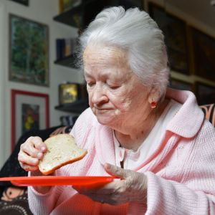
Grocery Program for Seniors
Many Seniors are forced to make the tough choice between buying food and medicine, and others struggle to prepare foods as they once did.
Notes:
Serving the elderly provides special challenges. This population is at greater risk due to their age and other medical conditions.
Your Club may be able to work with local pharmacies to serve as medication delivery drivers.
This may require some more exposure, but there are some drive-through pharmacies that will package up the medications for you to pick up and deliver to your “clients”.
If you have a Lion who will get out, but really wants to keep their exposure low, then they could serve as one of the delivery people

Slide 17
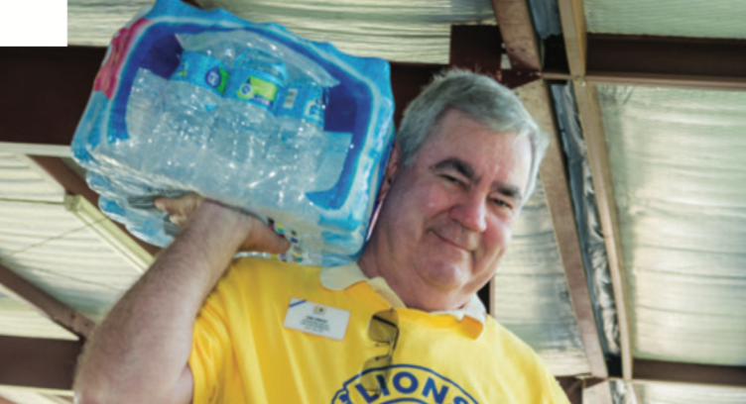
Disaster Food Assistance
When disaster strikes, local food banks kick into high gear, providing emergency food and disaster-relief supplies to families and households virtually anywhere in America.
Learn how your club can partner before the disaster strikes.
Notes:
The key to any Lions Service Project is preparation.
With hurricane season just a few months away, is your Alert Team ready? Does your District have a disaster plan in place that can help you to get needed supplies if and where they may be needed?
When natural disasters strike, the grocery stores empty out quickly. Is you club prepared with supplies and can it offer the community any immediate response? Have you identified club members who serve as the responders in the aftermath?
What role can your Club play in the collection and distribution of disaster-relief process?
Contact your local branch of the Red Cross now and see how your club can be prepared to respond in the event of a natural disaster hits your area.
This project really can apply for just about every member of your Club. Most everyone manages to get their own groceries into their homes – by some means. Use the same method, but just collect the additional supplies that you need for your Club’s Disaster Preparation Plan. This also minimizes the need to identify a central staging area where you drop off the supplies for later use should a disaster mobilize your members.

Slide 18
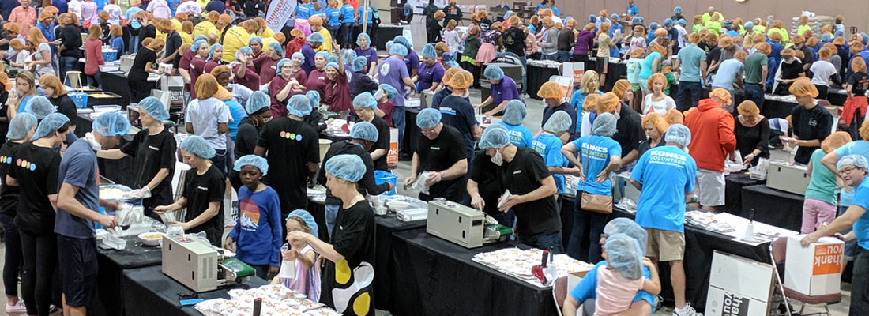
Host a Meal Packing Event
Plan an interactive meal packaging event with your workplace, civic club, faith community or school.
A group of 40-50 volunteers can package more than 10,000 meals in just a couple of hours.
Start planning your event today.
Notes:
The Club does not have to undertake the responsibility of mass distribution of food for hunger relief.
You can partner with another organization, the local government, or even the Red Cross.
Your Lions might be able to participate in some aspect of this event.
Just like the Quartermaster coordinating the distribution and allocation of supplies, your Club could provide the logistics behind the scenes if you are not comfortable assembling packages in a “kitchen” or warehouse or serving in a large food distribution line. Coordinating logists is probably one of the more satisfying tasks for someone who is detail-oriented and really wants to keep personal contacts at a minimum.

Slide 19
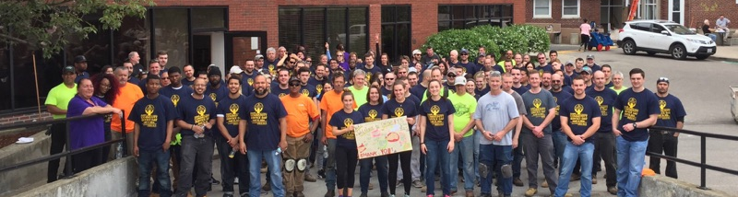
Engage Your Workplace
Lions can engage corporate partners and their employees in our mission to end hunger. Many Lions Clubs work with companies to help them reach their employee engagement goals as we serve those in need around the world.
Notes:
With so many organizations working remotely, your Lions Club might consider mobilizing their coworkers to offer support for a major hunger relief project.
This helps give their coworkers a sense of pride in giving back to the community. It also helps distract from worry and concern over the restrictions they may experience on-the-job.
Something to consider – many companies have lost the ability to coordinate company-sponsored service projects for their employees due to the Pandemic. Your Lions Club just might provide the avenue for your peers to complete their service hours in support of the company’s goals.

Slide 20

Champion the Cause
Advocacy is a vital activity in which our members can actively engage. Effective advocacy can engage and empower people toward changing laws, policies, systems and attitudes to end hunger.
Identify ways for your members to become a advocates!
Notes:
Advocacy takes on a modified platform through the Pandemic as traditional face-to-face encounters may not be possible given local restrictions.
Take this opportunity to see how your Club could champion a cause through the web or other social media outlets. If you have cultivated a large following, this could make a significant impact on the cause you are championing.

Slide 21

Volunteer
Volunteers are an essential resource to help realize the vision of a world without hunger.
Your Lions can join local organizations not only to package meals, but to support warehouse operations and assist with delivery and administrative duties.
Identify agencies near you and find out how you can get involved and help to end hunger in your community.
Notes:
If your Club simply isn’t prepared to coordinate a project because so many members have been adversely affected by the Pandemic, consider encouraging Lions to see out other volunteer opportunities through other agencies serving to relieve hunger in your area.
There may be local Volunteer Service Boards in your city or community where your members could get information about volunteer opportunities.
Your area may also have volunteer opportunities posted through a smart phone app like “That Helps” or “VoMo” (Volunteer Mobilization). As popularity grows for these new apps, more opportunities will be available that your members might not ever encounter.

Slide 22

“If you can’t feed a hundred people, then feed just one.”
- Mother Teresa
Notes:
Pick a service project that best meets your club’s interests and abilities
Assign tasks according to your members abilities and willingness to be exposed outside their homes
Invite your Clubs’ prospects to participate with you in your projects or service partnerships
Many people who are not members of service organizations are craving a sense of community and are looking for the pride in giving back.

Slide 23

Closing Thought
Service is what Lions do. If our members and our clubs are not serving the needs in our communities, then we have nothing to offer prospects in membership.
Notes:
If your Club is not serving the needs of others, its members will lose interest and retention becomes a challenge.
If you are not providing service, then what do you have to offer a prospective member?
“We Serve” is not just our motto, it is our rallying cry in these challenging times.
Now, we must be more thoughtful and creative when it comes to finding opportunities to serve others and provide a productive club environment for other service-minded individuals interested in making a difference in the lives of others

Slide 24
Objectives Met?
One
Now you know that Lions Clubs everywhere are serving and keeping their members engaged, despite the Pandemic
Two
You have some tools to you identify service opportunities for your Club
Three
You can select a right service project appropriate for each member of your Club
Notes:
Hopefully, you now have a better understanding how some clubs have adapted to serve others
You will learn how to find new opportunities to fill needs in your community
You will be able to look critically at your own club and weigh your own concerns to successfully identify appropriate service project opportunities
Now – as you serve, remember to post your

Slide 25

Thank you
PDG Mark W. Roth
MD2 – GMT Coordinator
MarkWRoth@aol.com
713.962.4194

