Slide 1


New Member Recruitment:
Preparation is the Key to Growth
Notes:
Engagement is the key to member satisfaction. A high level of member engagement will translate into stronger member retention. So today, we will talk about ways to get and keep members engaged in the Club.

Slide 2


Objectives
To help you prepare your club for success in New Lion recruitment
Show you how to make Membership a priority in your Club
Illustrate how you can prime your members and club for new member growth
Notes:
The goal of this presentation will be to help you understand the following …
That preparation is key to sustainable membership growth
Show you the importance of making “Membership” a priority if you want to grow in Helping Hands for service
Give you a better idea how to prepare your club and members for a New Member Recruitment plan

Slide 3
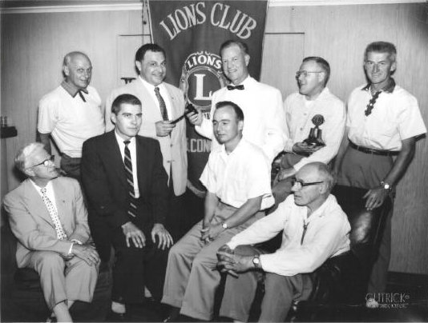

Preparing Your Club to Recruit
Considerations
Club attractive to Prospects?
Are Club meetings fun?
Meeting time, day and location?
Are your members serving?
Members get “value” for the dues?
Notes:
First, take a good look at your club.
Are your meetings boring?
Is your Club actually performing service and is that service valued by your members?
Is the process for signing-up a new member tedious and complicated?
Are the dues reasonable for your members, as well as your prospects?

Slide 4
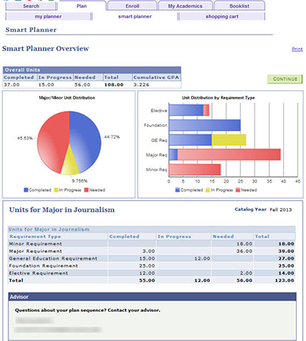
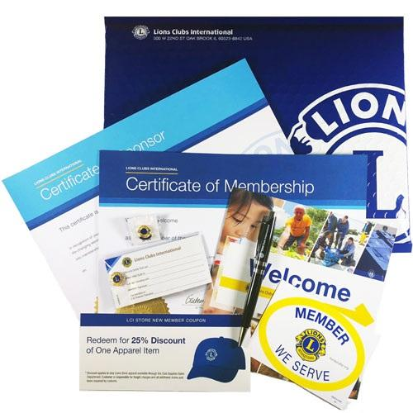

Planning is the Key to Success
First Things First
Support from the Members
Select a Champion and Team
Develop Strategies and Goals
Make a Plan and a Budget
Order New Member Packets and Applications
Notes:
Before you think about developing your Membership Plan, there are a lot of things to consider – solicit input from your members and build consensus for your plan.
Pull a team together – the Club’s Membership Chair may the right Champion – but he or she needs to be focused on Recruitment
Create a Plan with action items for everyone – the plan may include budgeting for items essential for success
Make sure that you have plenty of New Member Kits from Lions Clubs International

Slide 5
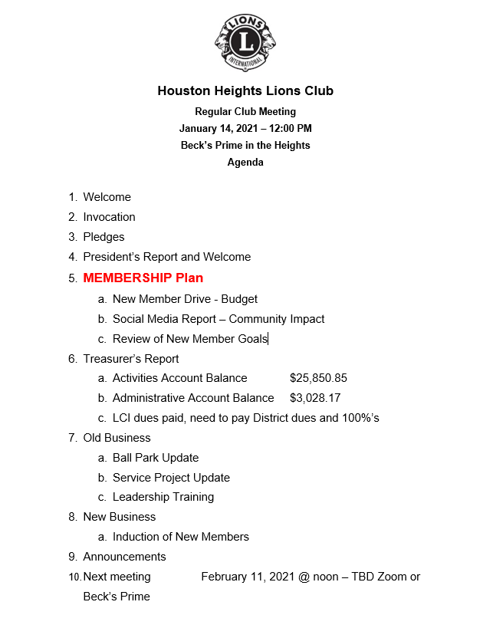

Prioritize Recruiting
Make Recruiting the Priority
How does this activity help me to recruit new Lions?
Recruitment is the first item on every meeting agenda
Review Goals and Progress
Notes:
If the Club President isn’t promoting membership recruitment, it will not be a priority for the members
Membership should be a top priority of every club
Discuss some aspect of membership at every Club and Board meeting
Share historical membership data and review goals – How long has it been since your Club brought-in a new member?
Look at everything you and your Club do and ask this important question: Will this activity help us recruit new Lions?

Slide 6

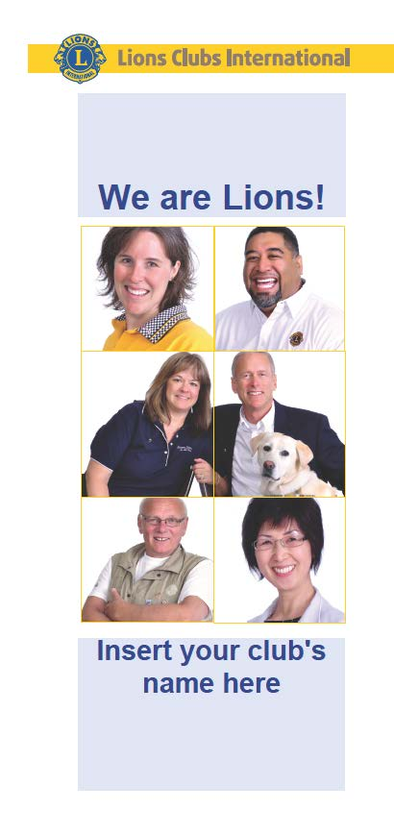
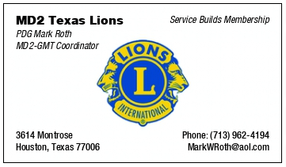








Recruitment Tools & Supplies
Obtain Marketing Materials
Business Cards
Club Flyer
Elevator Speech
Update Social Media profiles
Houston Heights Lions Club
Notes:
Perhaps the most overlooked area of most clubs is Marketing and Public Relations
Do you have the tools you need to present your club in a favorable light?
Business cards – give thought to the content – simple in appearance, not too busy
Professional-looking printed materials - Is it consistent with the content and “image” you want to project for the Club?
Have you practiced what you would say to a prospect besides: “Hey, you should be a Lion”. Give serious thought as to what your Club offers a prospect. If you don’t like what you currently are offering a prospect, then NOW is the time to review and make changes
Is your social media current and relevant? Again, is it consistent with other messaging from the Club? Do you feature your activities on newer apps like Snapchat, TikTok and Instagram?

Slide 7
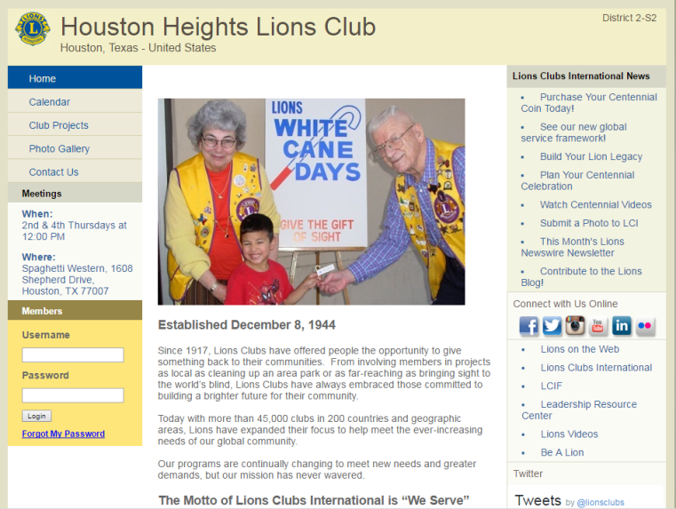
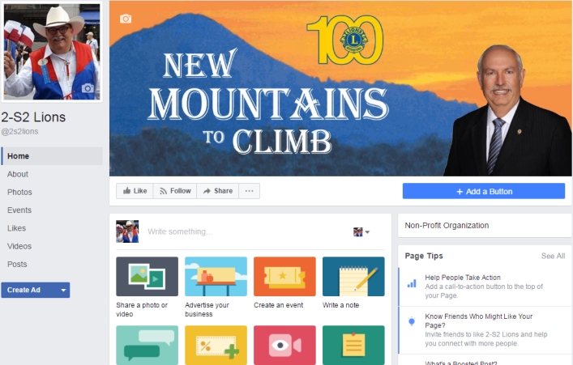
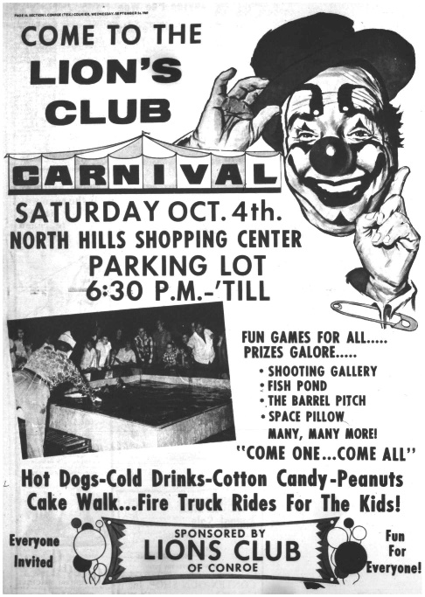
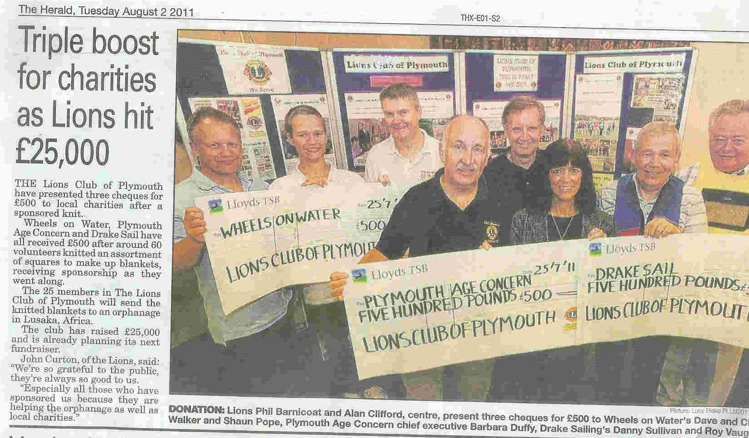
Club Visibility
What will the Community Find?
Club Facebook Page
Club Website
Lions’ Facebook Profiles
eClubhouse Page
Other Media
Notes:
If you don’t have a web page, consider getting one – Remember, if you want to attract new, younger prospective members, then use the tools that they use to get information about the world around them.
LCI offers eClubhouse to all Clubs to use to create a home page if they do not have the expertise for even a simple web page.
Link all your Club’s social media tools to each other and encourage your members to link their accounts with the Club. Don’t be shy – ask your friends to “Like” and “Share” your page and content. This increases the visibility of your Club in the social world of the “interwebs”.

Slide 8
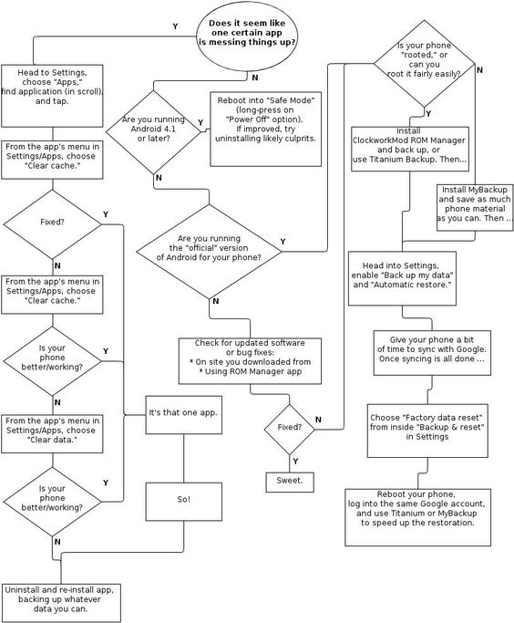
Process for Adding Members
How does one “join” a Lions Club?
What is your Club’s process and cost?
Is the process clear and easy?
Does everyone understand it?
Keep it simple
Notes:
How complicated is it for your Club to bring-in new members?
One club may allow the members to simply bring in someone who expressed interest in joining and paying only the application fee. Another Club may expect all prospects to express interest, participate in a Club service project, pay an entire year’s dues and come up with at least one service project idea.
Are your members “voted” on by the Board or the entire Club? Or is any member in good standing allowed to simply announce their “New Lion” at a club meeting.
One process might work in one club, but not work in another. It’s YOUR Club, make it as simple as your members see fit. Remember though, the easier it is to become a member of your Club, the quicker they can get on the books, start paying paying dues and begin serving the community. If it takes too long after they expressed interest in joining, then they may lose interest 3-4 months later.

Slide 9
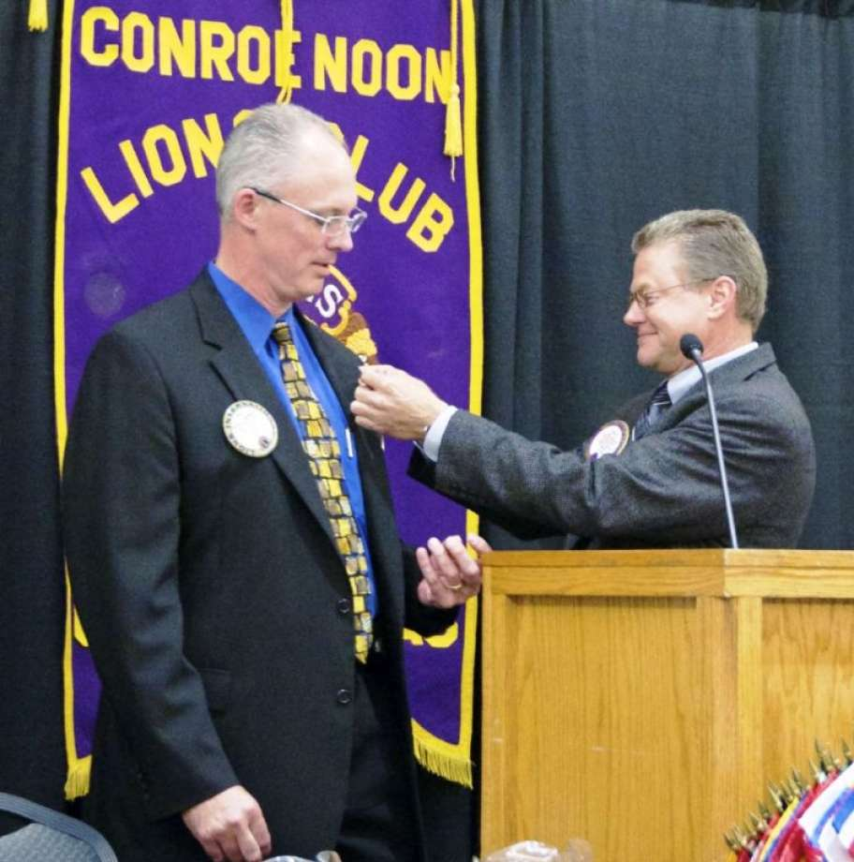
Engage All Your Lions
Everyone is on the Team
Understand the Process
Everyone has New Member Applications
Develop an “Elevator Speech”
Develop Members into Good Lions Mentors
Notes:
Every Lion who loves serving others will want to bring in more prospects.
Make sure that everyone understands the process for bringing-in a new Lion
Do all your members have new member applications with them at all times? I guarantee you that the Lions who have successfully recruited 250+ Lions in their lifetime keep a healthy supply and thoroughly understand the process for recruiting
Give some thought about why you are a Lion. The reasons you joined years ago may be different from the reasons you remain in your Club. Now that you know so much more about the Association, and the service projects and potential of the Lions, you probably have a lot of reasons why you are a Lion.
You should give some thought to what you would tell a prospect. Keep it short and simple. If they are a community leader interested in meeting local needs, don’t lead with LCIF’s humanitarian relief overseas. You might want to share how Lions Clubs in the District are serving right in their own communities.

Slide 10

Summary: Be Prepared & Keep it Simple
You’ve seen how to prepare your Club for New Lion recruitment
You know how to make member recruitment a priority
You can prepare your members and Club for a push for new member recruitment
Notes:
This presentation has illustrated how to prepare your Club and its members to go out a recruit new Lions.
Everyone in the club should know to make recruitment a major priority for the Club
Now you can create and implement a New Member Plan that includes helping all the members use their experience and Club resources

Slide 11
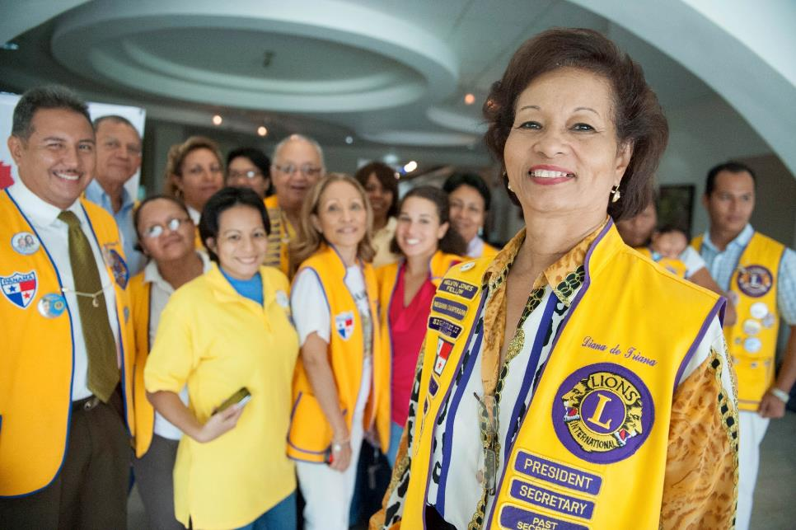
Thank you
PDG Mark W. Roth
MD2 – GMT Coordinator
MarkWRoth@aol.com
713.962.4194

